Slide 1
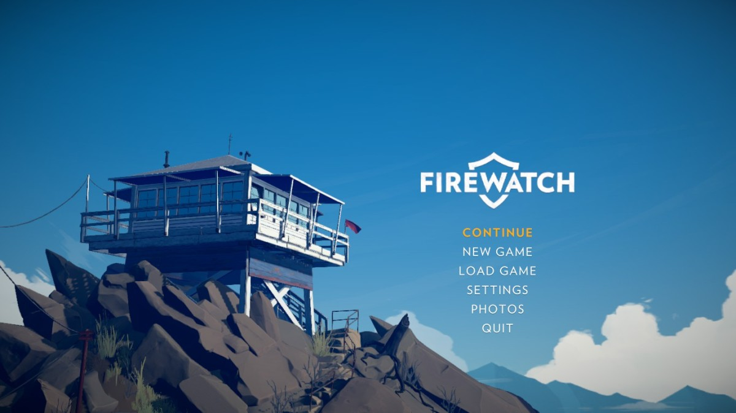

User Interface
DESIGN
THE JAMES YOUNG
HIGH SCHOOL
Computer Games Development

Slide 2

The general principles
Structure
simplicity
visibility
feedback
tolerance
reuse

Slide 3
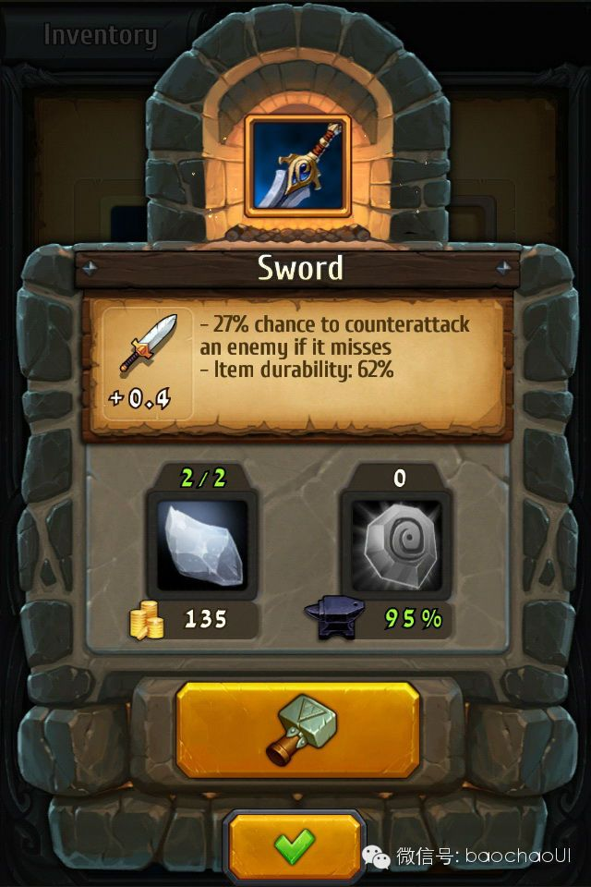
Structure
The structure principle deals with the architecture of the interface/ how the interface is constructed.
A UI should be based on clear models that are apparent (not trying to hide) and recognisable (to enable ease-of-use)
Notes:
In the example above, Dungelot 2, the crafting button shows a recognisable hammer. It’s brightly coloured to contrast with the surrounding graphics indicating it can be clicked. It has a button look and shape to it as well. Currency is shown with a familiar icon.

Slide 4
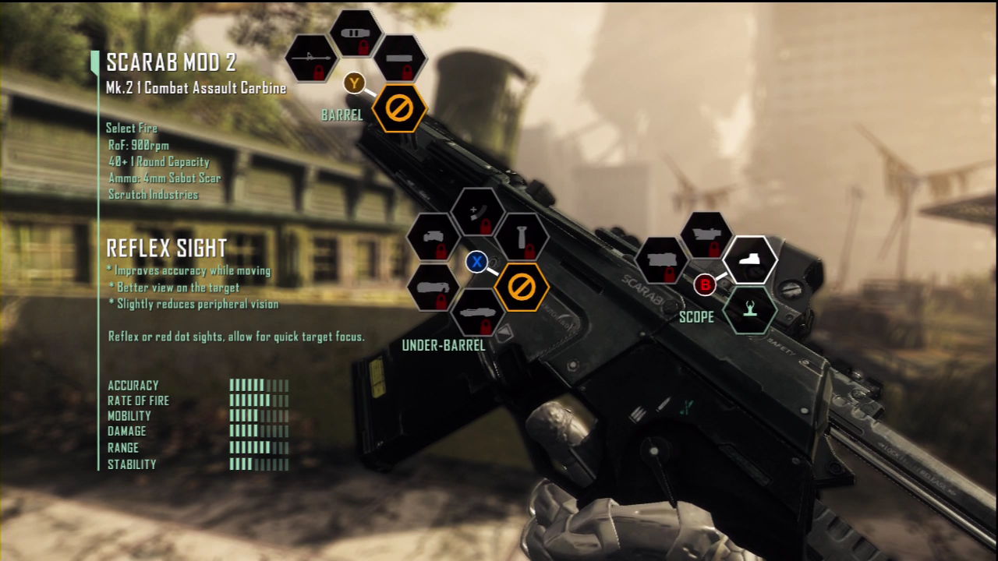
example:
Crysis 3
Notes:
In the example, the modifications that can be made to the weapon is based on a realistic model. For example, modifications to the scope are shown on the scope of the weapon so that players can easily understand what part of the weapon they’re altering. Options that are locked, show a padlock. We all understand a padlock represents something that is locked and needs to be unlocked.

Slide 5
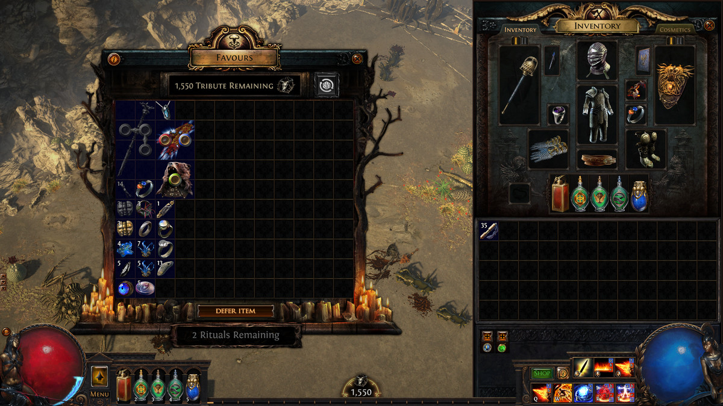
example:
Path of exile
Notes:
In the example, the equipment that the player can wear is shown on the right. Each slot is for a specific part of the body e.g. chest armour, helmet, hand 1, hand 2 etc. There are no items of text to describe these areas so it’s less clear where things go. Players learn through trial and error or possibly through a tutorial.

Slide 6

simplicity
The simplicity principle is all about making basic, common tasks easy within the UI
The design must communicate with the player in their own language.
It must also provide shortcuts to assist in completing long, complicated procedures
Notes:
The act of quickly healing the player during frantic gameplay is usually done by using a quick button/key. Most games don’t require the user to have the healing device in their active hand to use as this takes time and interrupts play.
The same goes for reloading weapons – this is usually just a button/key press away. However, a growing number of VR games require realistic mechanisms for reloading such as ejecting a magazine, grabbing a clip from their belt, inserting this into the gun, and then chambering the first bullet. This is more to keep the immersion in place and provide a different experience to gameplay.

Slide 7
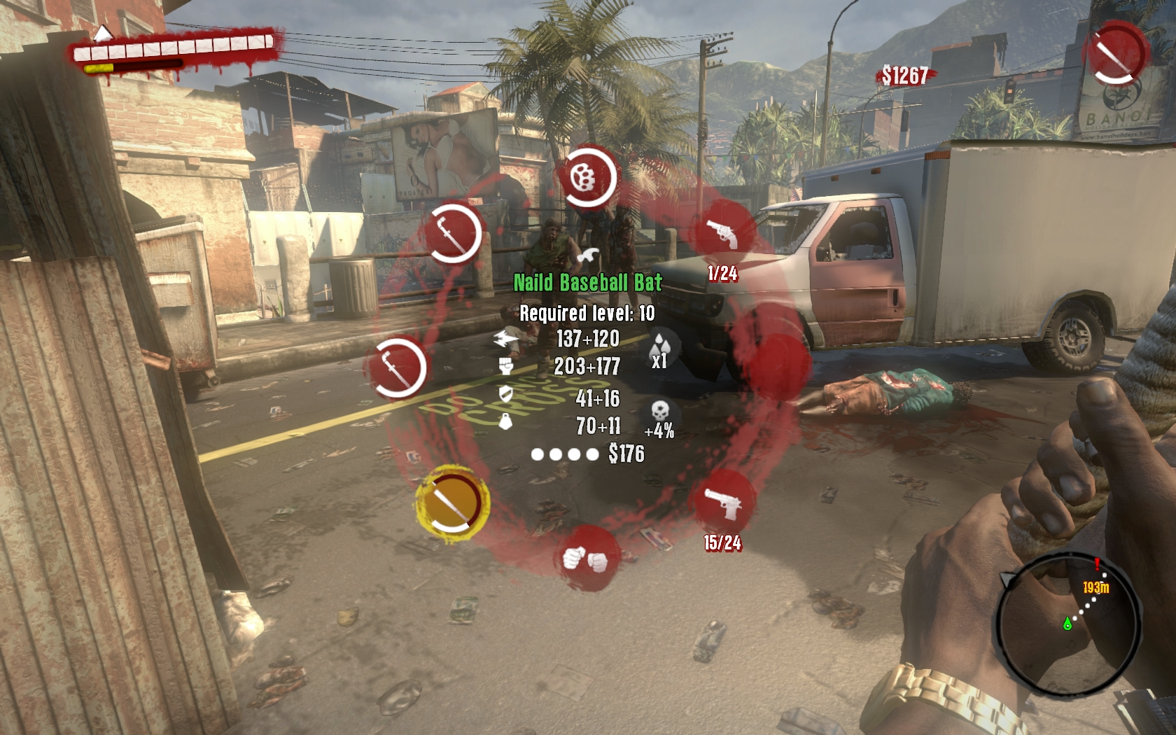
example:
Dead island
Notes:
The process of swapping between a large collection of weaponry is often controlled by scrolling on a mouse or cycling through items using a controller. Going too fast or too far can cause problems during gameplay and possibly irritate the player. Dead Island used a quick key/button to bring up a radial menu. This allowed quick select of items and meant players didn’t have to go through an ordered list to find a specific item.
It also provided information on the durability of each weapon, the ammo count of guns and basic damage stats.

Slide 8

simplicity
Interfaces should put related items together and separate unrelated items
They should also differentiate dissimilar things and make similar things look like each other.
Notes:
Health and Mana (magic) potions are a great way to explain this. Both are consumable and therefore share the same shape of bottle but they both affect different things and therefore are different colours. Red is always associated with health whilst blue is usually associated with magic.

Slide 9
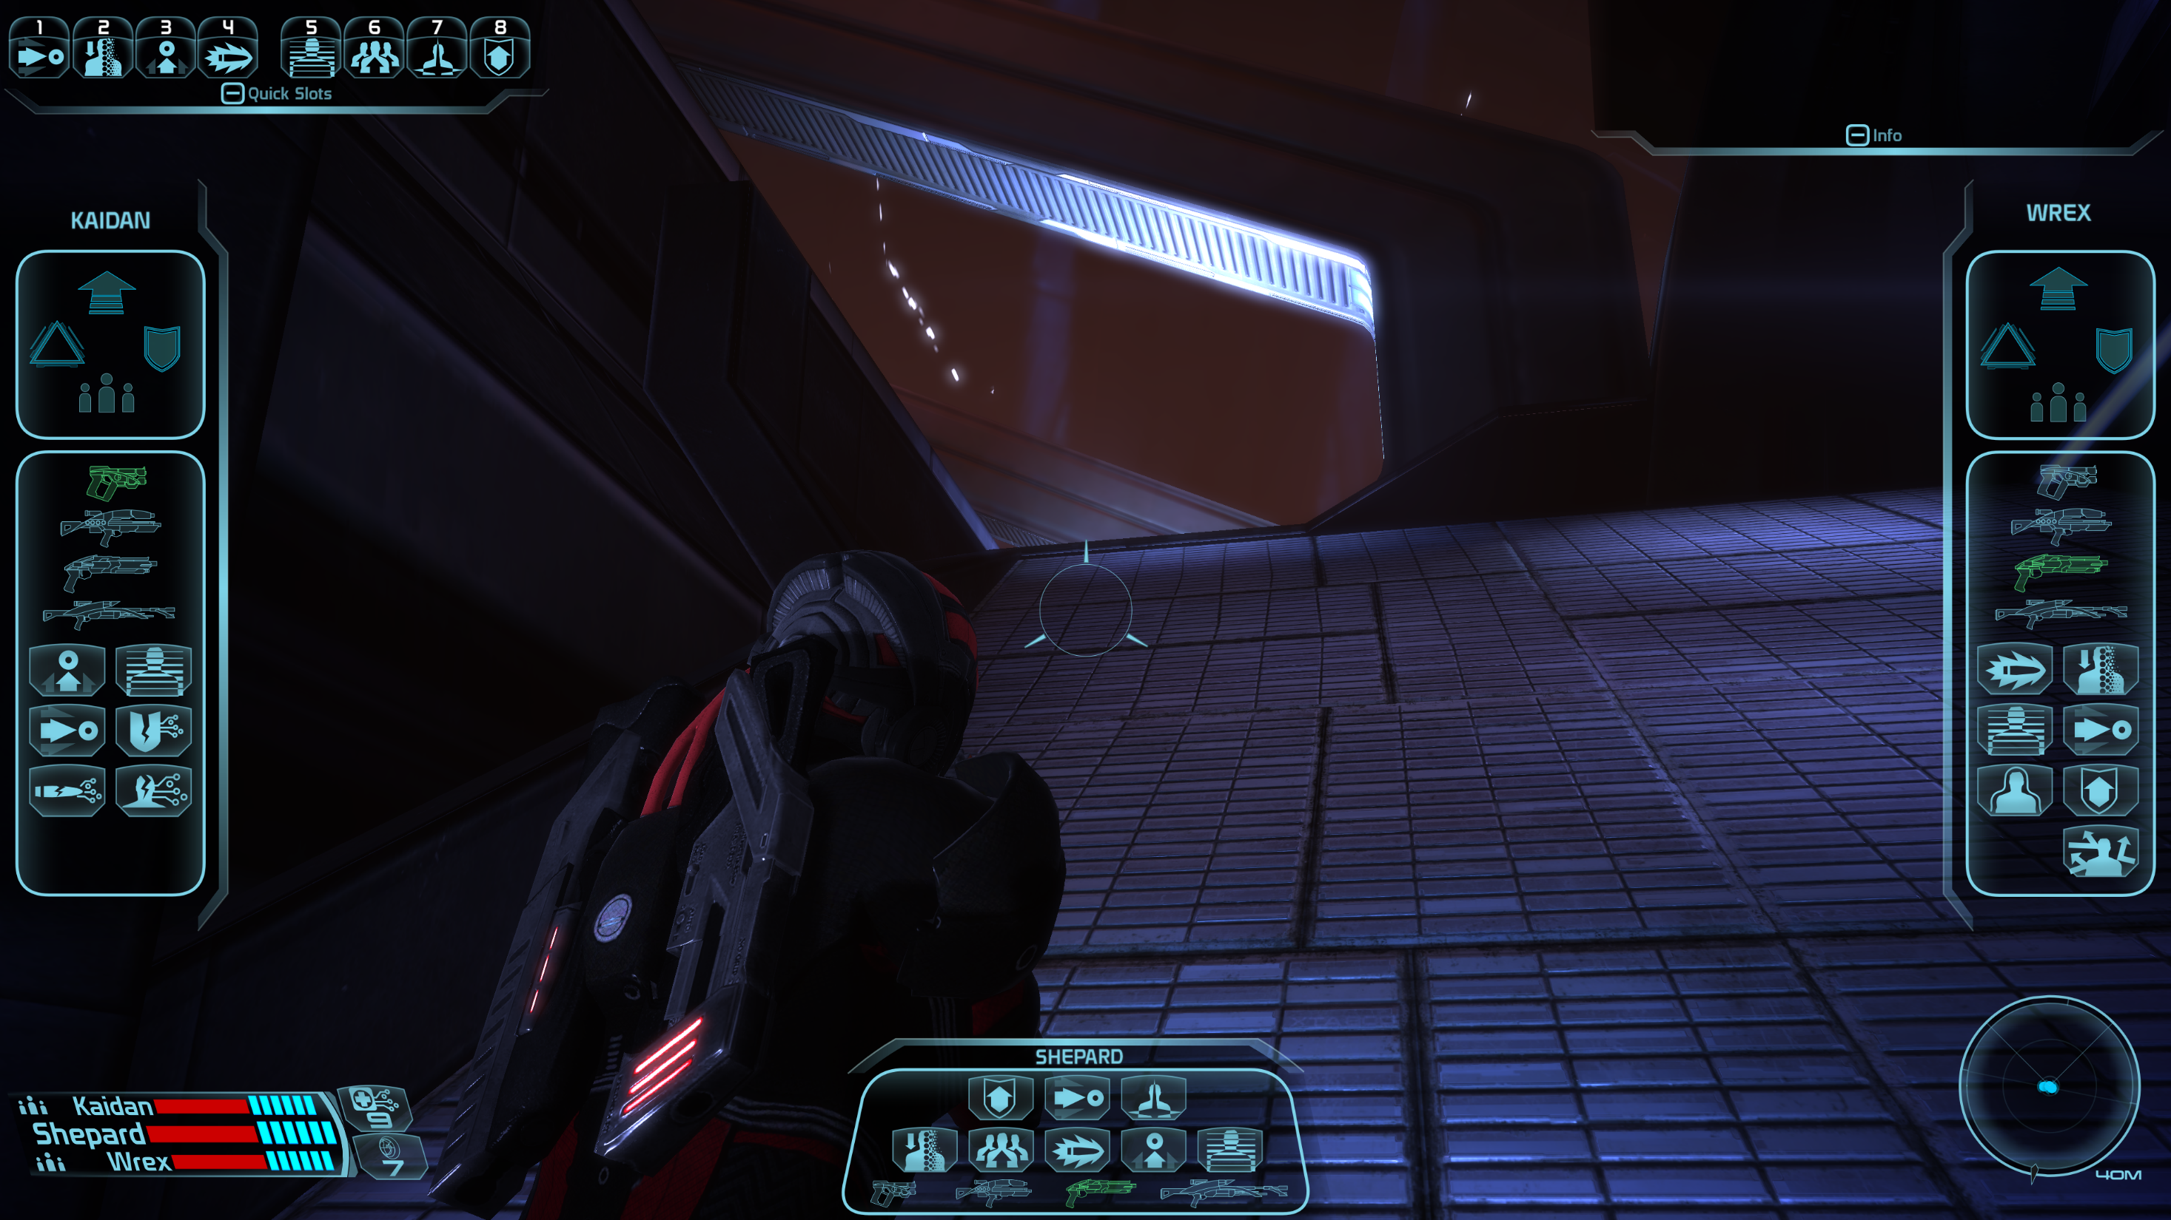
example:
Mass effect
Notes:
The original Mass Effect on the PC has a great UI for discussing Simplicity. The player’s weapons and abilities are grouped together and placed at the bottom centre of the screen.
Their teammates (AI controlled) are placed on either side to separate them out, away from the player’s own icons. They use the same icons so the player is familiar with them. There are commands for the teammates above the weapon icons and these quickly allow the player to order their teammates around.
The bottom left shows the health and shield status of the player and the 2 teammates – grouped together so the player doesn’t have to go looking around for them.

Slide 10
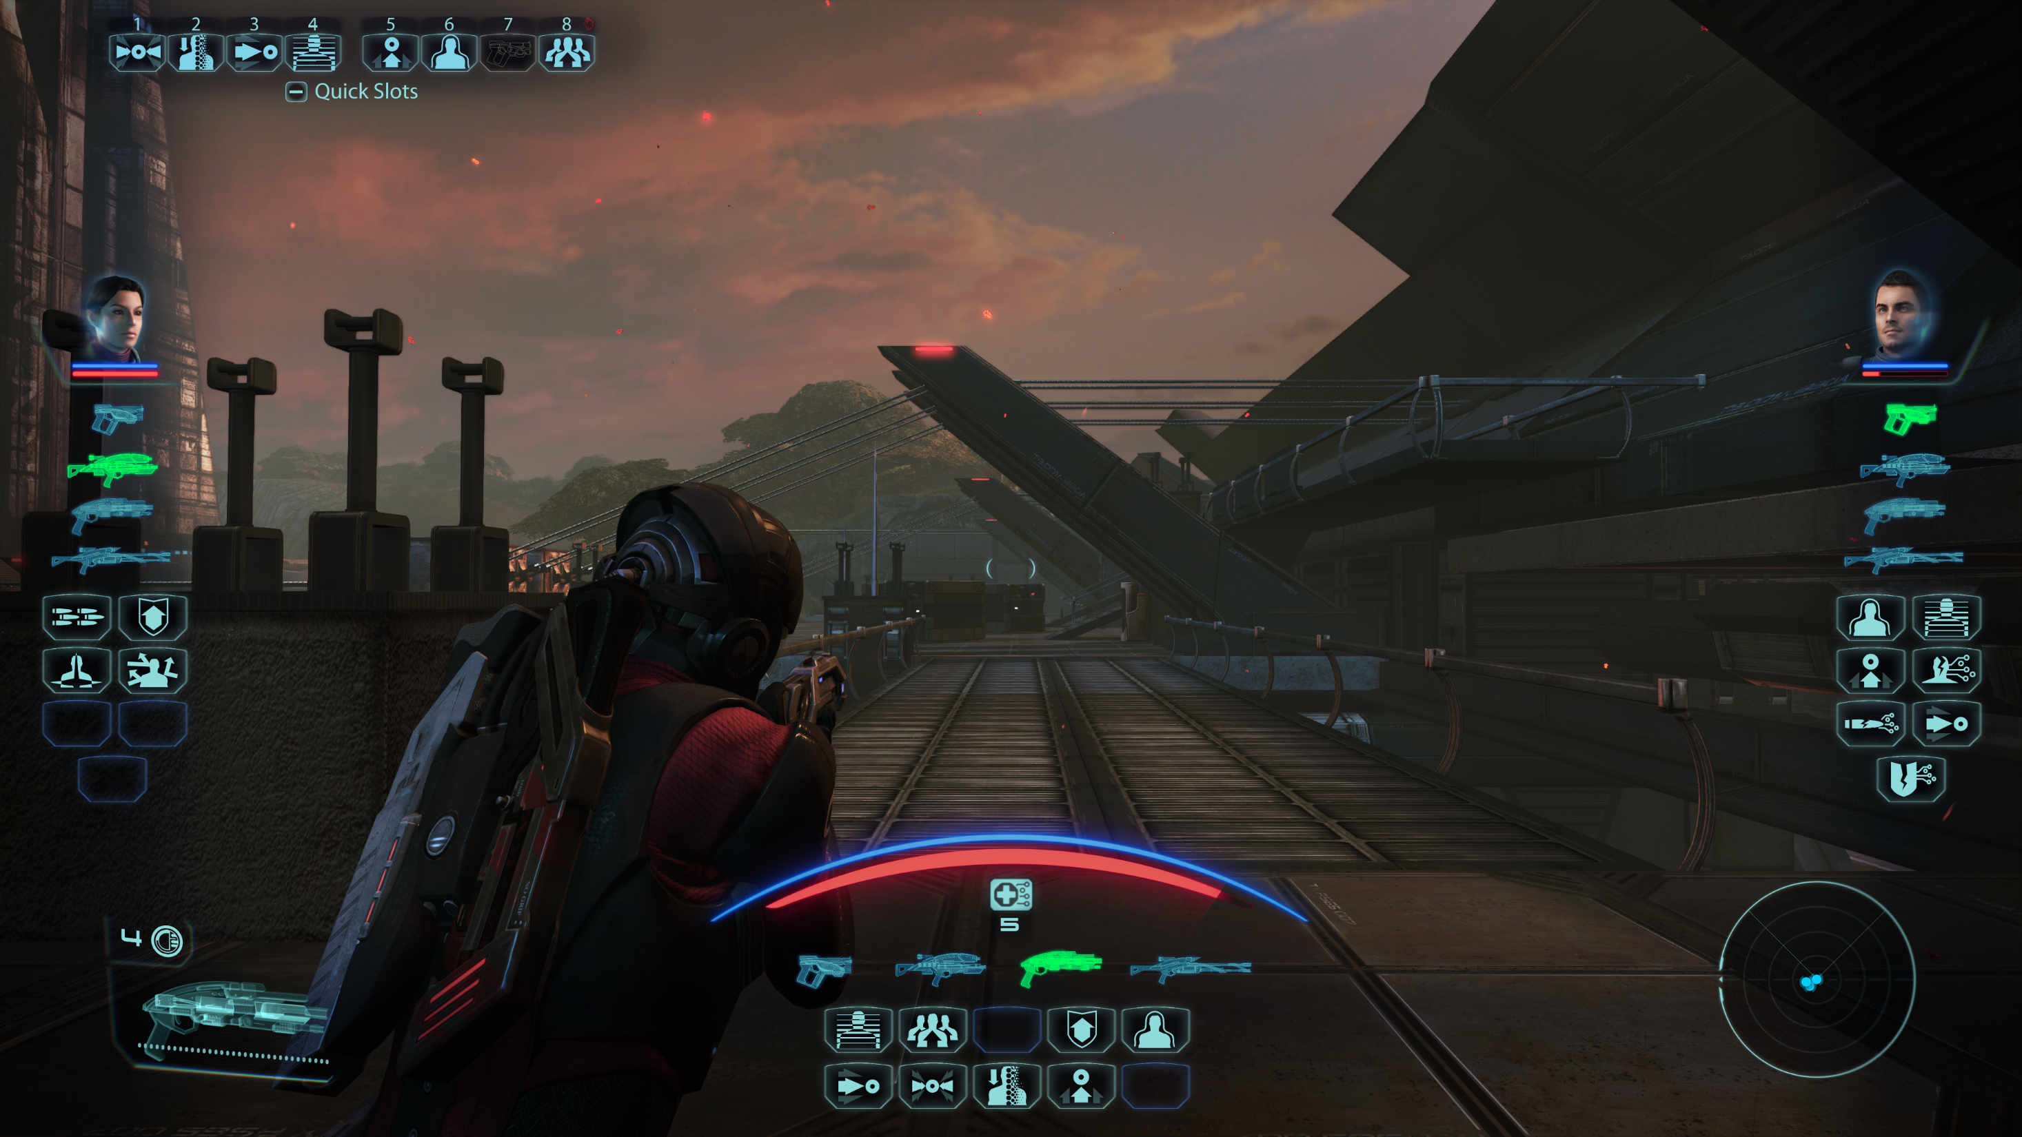
example:
Mass effect LE
Notes:
Mass Effect LE is the Legendary Edition which brings together all 3 games plus every bit of DLC into 1 game. The graphics and UI were overhalled to bring the first game up to a more modern standard.
The health and shield bars are very different and have now been separated out. This probably makes it easier to identify who’s low on health/shields. The player’s is in the centre of the scree, under the reticle (target in the middle of the screen). This will make it easier for the player to quickly glance at their own stats and gauge how well they’re doing.
There are no borders around any of the grouping. This is probably to aid in immersion and to reduce distractions from the screen.

Slide 11
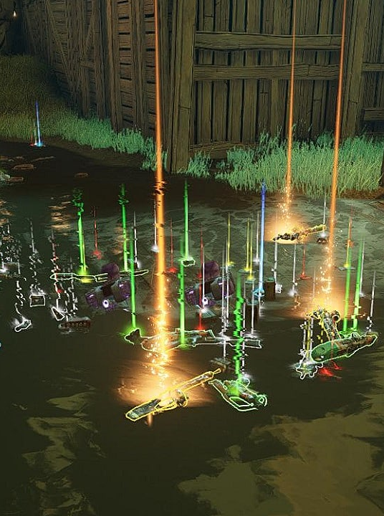
visibility
According to this principle, all options and required materials for a set task should be easy to spot without distracting the player with unnecessary information.
Notes:
The image is from Borderlands 3. The game sells itself on the sheer volume and variety of guns that can be dropped from enemies/crates as rewards. Like a lot of games, they used a colour coding to highlight rarity. Here it goes White->Green->Blue->Purple->Orange with Orange being the rarest and most powerful drops. The gameplay is fast paced and very colourful with various explosions and damage colours so to help make the drops more visible, the developers using a vertical coloured beam to draw attention to drops. In addition to this, the minimap will show the location of any legendary (orange) weapons that have been dropped but not collected.
Most games make interactive elements visible with glows, sound effects or animations. For example, a bouncing or spinning ammo pack easily alerts players to an item which will help them replenish their ammo.

Slide 12
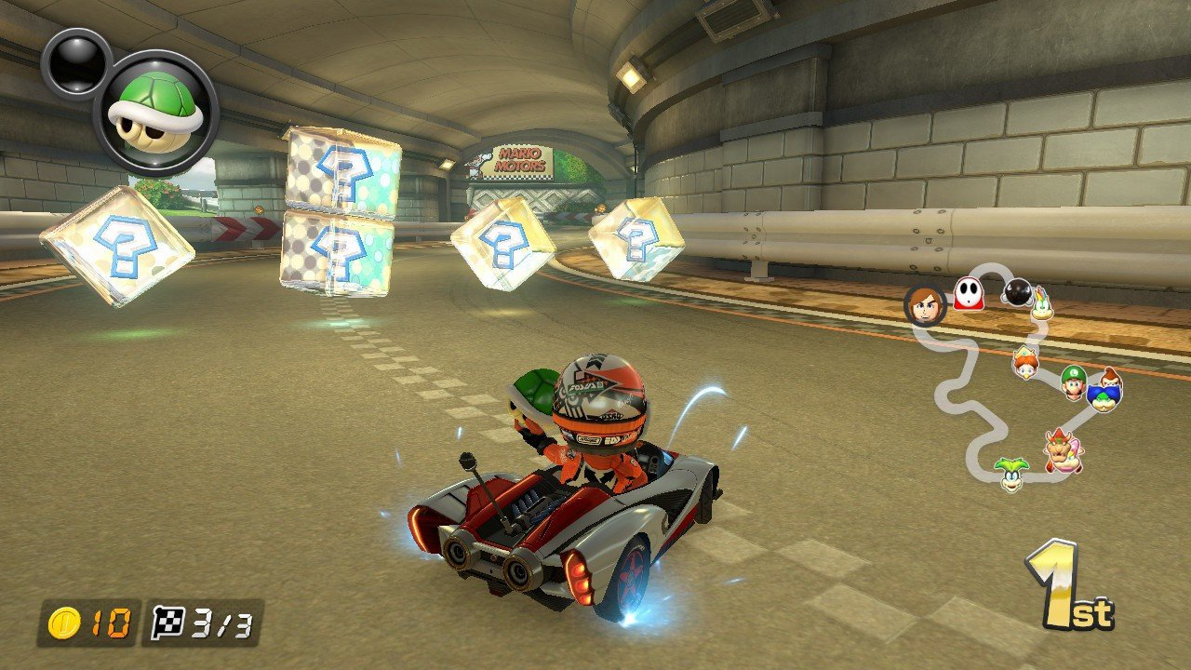
example:
Mario kart
Notes:
Mario Kart is a classic example of a game with high visibility. Pickups float above the ground and are designed to draw the player’s attention.

Slide 13
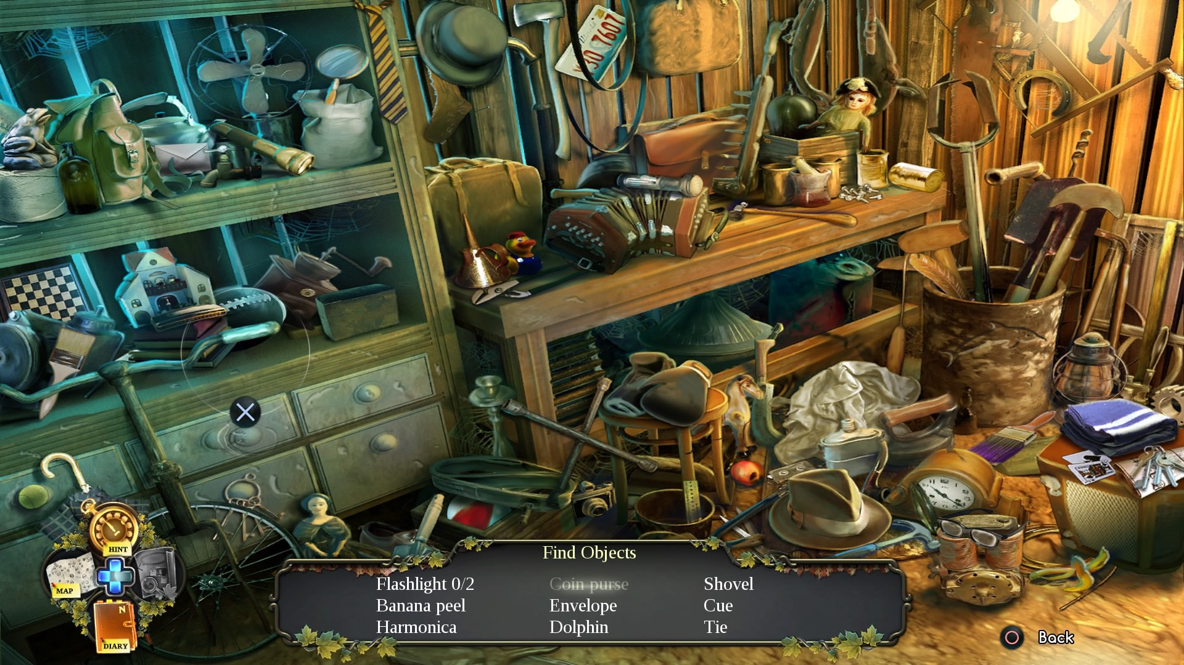
example:
enigmatis
Notes:
Enigmatis is a game that is specifically designed to break the visibility principle. In the game, the player has a list of items to find. These items are deliberately designed to blend in with the background art to make it harder for the player to play.

Slide 14
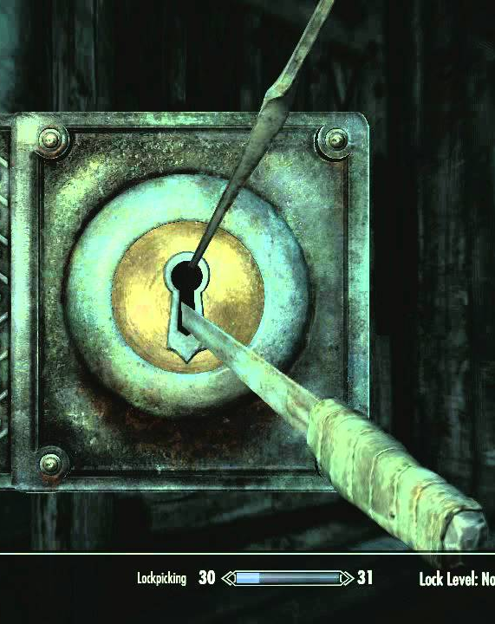
feedback
This principle states that the UI should keep players informed about their actions:
  new areas
  stealth
  changes to their condition (health)
  and relevant errors (failure to pick locks, no targets)
This information must be clear, precise and in a language the player can understand
Notes:
The lockpicking mechanic from Skyrim provides a number of feedback actions to the player. The Player needs to rotate the top pick to find the sweet spot that will unlock the chest. When the player attempts to open the lock, the top pick will shake to indicate it’s not in the right position. The longer they attempt to pick the lock, the more likelihood the pick will snap (audible feedback). There is a faint click noise when the top pick is in the right position.
Stealth is also a great feature to talk about here. Which methods do games use to tell the player whether they’re hidden/can be seen etc. Some games have a meter which fills up, others have an icon like an eye that opens and then changes a colour.

Slide 15
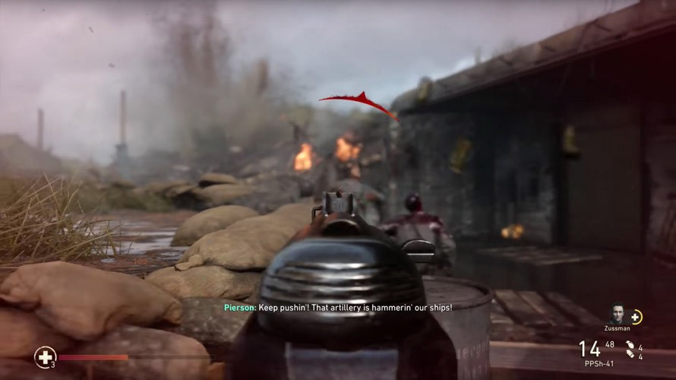
example:
Call of duty
Notes:
FPS games needs to inform the player that they’re taking damage. There are different systems to do this. In Call of Duty, the damage is shown with a radial arrow that’s red. The arrow points towards the direction of the incoming damage and red draws the player’s attention indicating a health/blood issue.
Other games show the damage indicator around the edges of the game. This increases immersion and can’t cause a sense of panic. There’s an interesting article about it here: https://medium.com/@jasper.stephenson/a-ux-analysis-of-first-person-shooter-damage-indicators-59ac9d41caf8

Slide 16
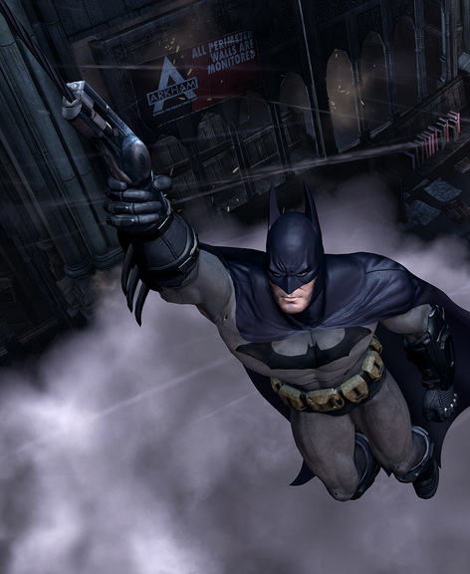
tolerance
The UI should be tolerant and flexible
It should reduce the cost of mistakes made by the player through undo and redo functions (buy-back in shops, automatic recovery in Batman: Arkham Asylum).
Errors should be minimised by accepting varied inputs
Notes:
In the Batman Arkham games, whenever the player slipped off of a ledge/building, the Batman would automatically save himself and grapple back to safety. This was a nice touch as players shouldn’t be punished harshly for a small movement mistake.
Buy-back is also a nice touch and found in a lot of games from different genres. If a player accidentally sold the wrong item, they could “buy back” the item without penalty.

Slide 17
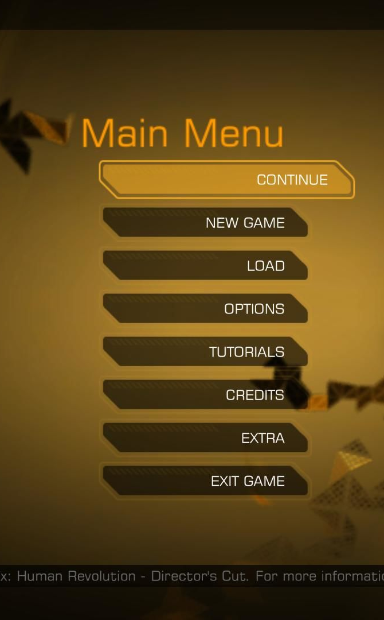
reuse
This principle states that an UI should reuse internal and external components/behaviours (themes and menus)
Maintain consistency and thereby reduce the player’s need to rethink and remember
Notes:
The menu on the right is from Deus Ex: Human Revolution. Each menu item’s shape is reused within the game to highlight clickable buttons. The colour scheme and fonts are all reused to provide a consistent UI (much like when we discuss consistency with Web Design & Development at N5/H)

Slide 18
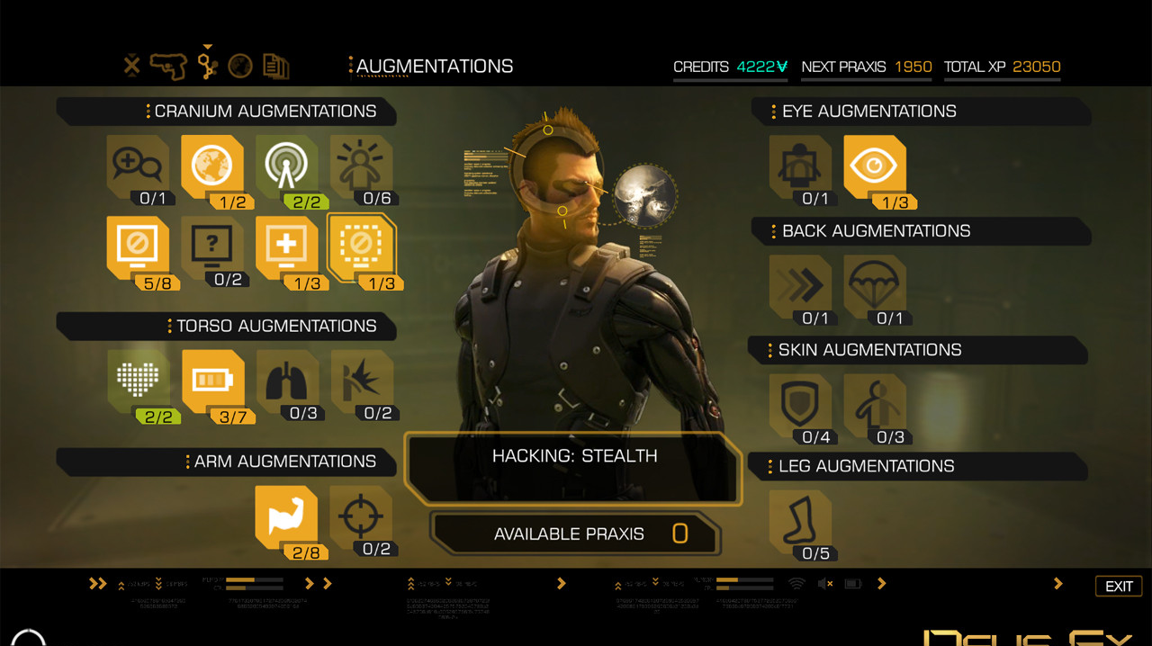
example:
Deus ex: human revolution
Notes:
Here is the “levelling up” menu where players can put points into “augs” or abilities. The shape of the abilities match that of the main menu as do the fonts and colours used.

