Slide 1
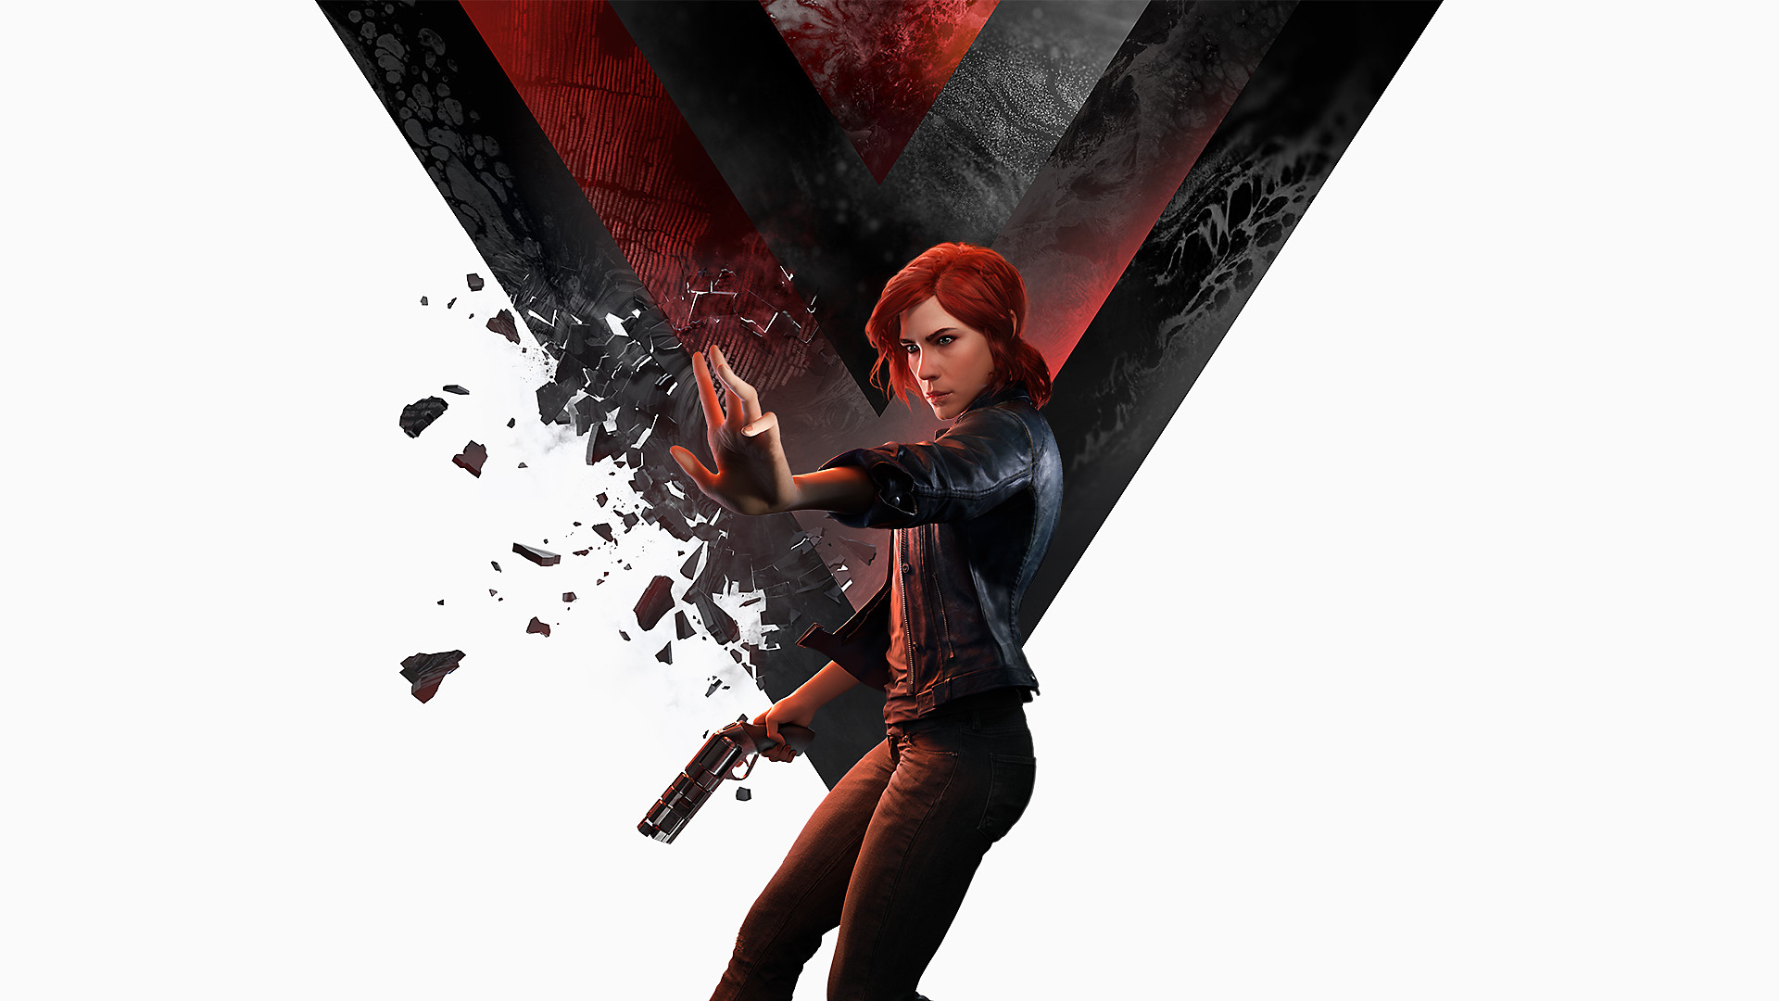

Narrative
THE JAMES YOUNG
HIGH SCHOOL
DESIGN
Computer Games Development

Slide 2
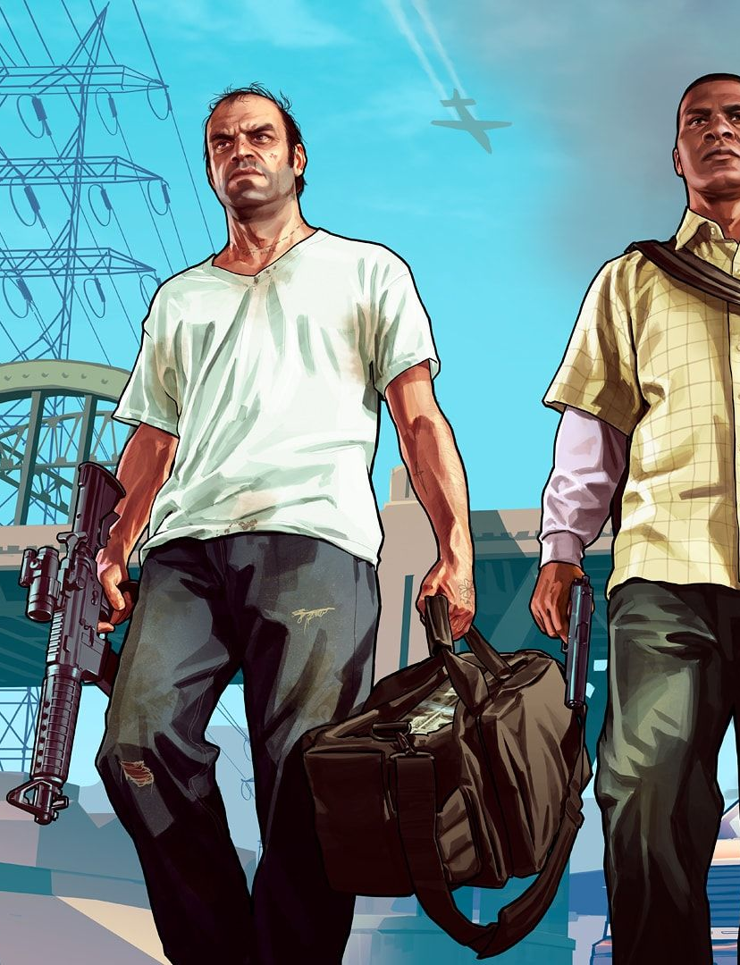
What is narrative design?
A well thought out story usually with a beginning, middle and end
Introduces the goal or objective of the game
Cut scenes or in-game sequences can be used to move the story along

Slide 3
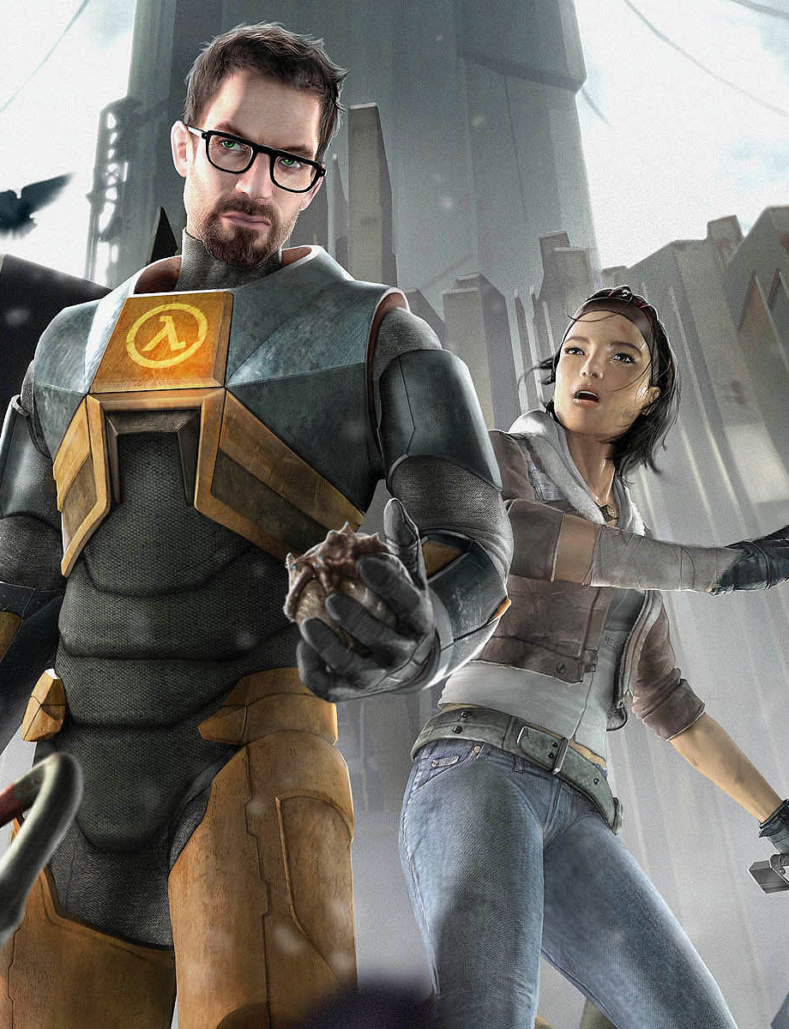
The story arc
This is the main storyline in the game and usually exists throughout the levels/areas
  An Embedded Storyline
  A storyline that unfolds through cut scenes regardless of the player’s actions. examples?
  An Emergent Storyline
  A storyline that is changeable and directly affected by the player’s decisions. examples?
Notes:
Emergent examples include Prototype, Outriders and most FPS (Call of Duty, Half-life) etc.
Emergent examples include The Witcher series, Mass Effect series and most RPG (Dragon Age, Elder Scrolls) etc.

Slide 4
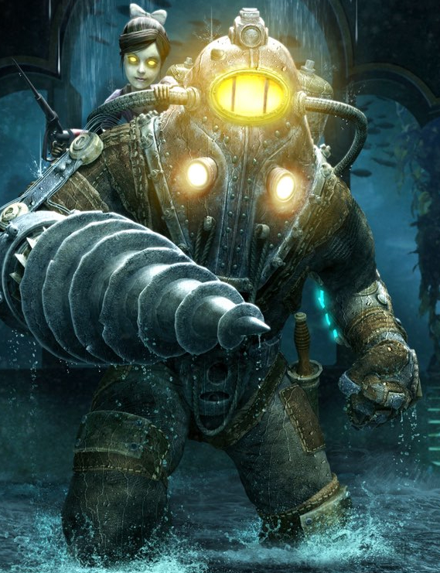
Narrative structure:
Linear
Structure is the way a story is told
A linear story cannot be changed and is the same every playthrough
This makes it easier to build, test and polish
Notes:
Most older games have a linear structure such as Doom 2, Bioshock, some God of War games. Arcade games tend to follow this method.
You can read more about the demise of linear games here: https://www.gameskinny.com/in1ca/what-happened-to-linear-games-and-are-they-due-a-resurgence

Slide 5
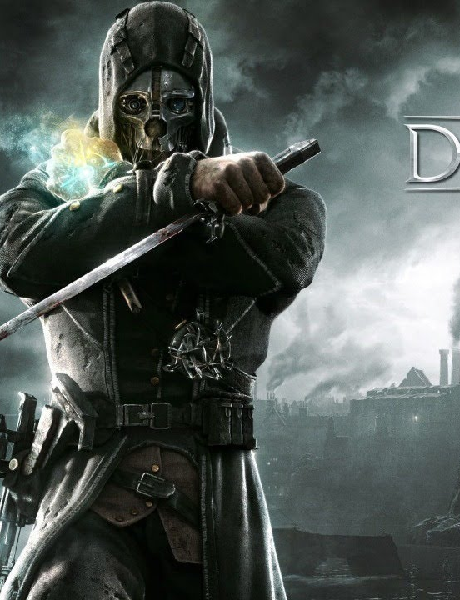
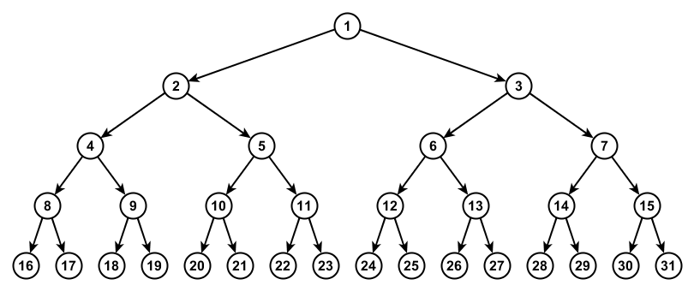
Narrative structure:
tree
At certain points, decisions are made by the player
These send them down a particular path
Notes:
Usually these are Good vs Evil choices and the player is placed on a scale depending on their choices. A binary choice makes the coding simpler to build and test when compared to the web route but they provide a replay value as the player can play the game a second time and make different decision. Example games = Dishonoured, Infamous, Star Wars: Knights of the Old Republic

Slide 6
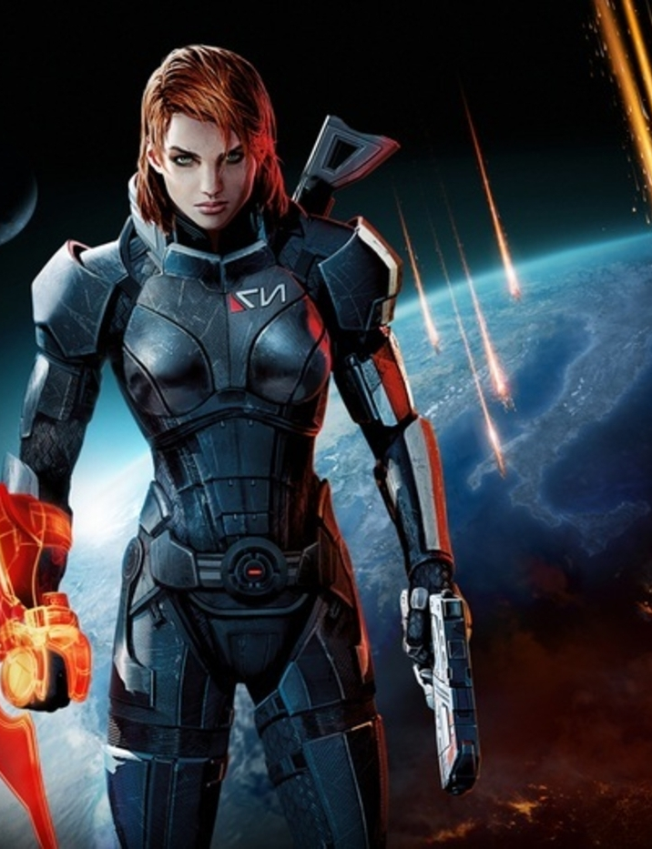
Narrative structure:
web
More decisions are given to the player which affect smaller storylines.
These smaller changes can have a larger impact to the main storyline and provide multiple endings
Notes:
More complicated to implement but provides a more involved storyline.
Examples include Dragon Age, where decisions at the start of the game affect the story drastically as it unfolds (groups of people are no longer friendly/hostile, new quests open up whilst others close, new equipment/abilities become available etc.
Some games can carry decision made into sequels. For example, in Mass Effect, deciding to save one individual affects the story in Mass Effect 2 as the individual now rules a planet.
Very time consuming to test and implement but provides a large amount of replayability.

Slide 7
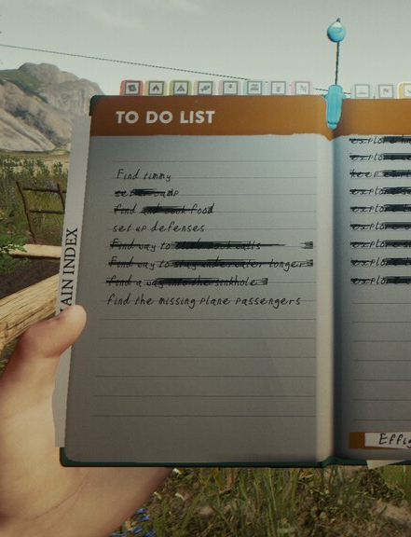
The 4 narrative layers:
events
Actions that are completed in sequence to advance the game
find the enemy > kill them > collect item/key
find npc > help/give > collect map/info/item
Notes:
Sometimes referred to as objectives.
Some objectives aren’t events however, as they are “side quests” and used to provide the player with additional experience/money/weapons and do no advance the story.
Only objectives that directly tie to storyline advancement are classed as events

Slide 8
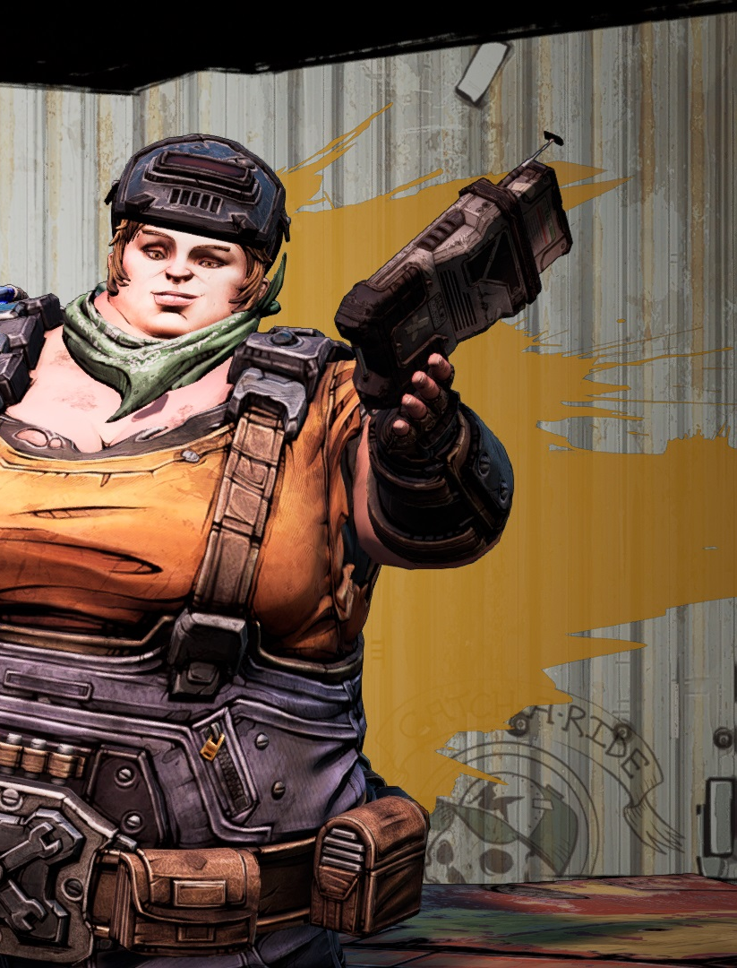
The 4 Narrative Layers:
Story Persons
Non-Playable Characters (NPCs) that perform actions to progress the story
They can happen with the player’s character being present or at a different time/location
Notes:
NPCs who provide objectives/quests associated with moving the main story arc along

Slide 9
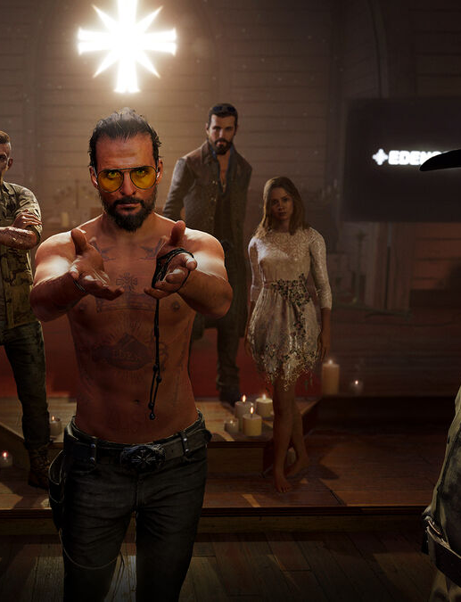
The 4 narrative layers:
Story telling
Methods used to tell the player the story
Cut scenes – scripted sequences for players to watch
Dialogue – most common technique
Narration – less common but seen more in RPGs
Notes:
Cut scenes either use the game’s own engine to generate or are separate clips of CGI. Old games used live action cut scenes (Resident Evil, Wing Commander)

Slide 10
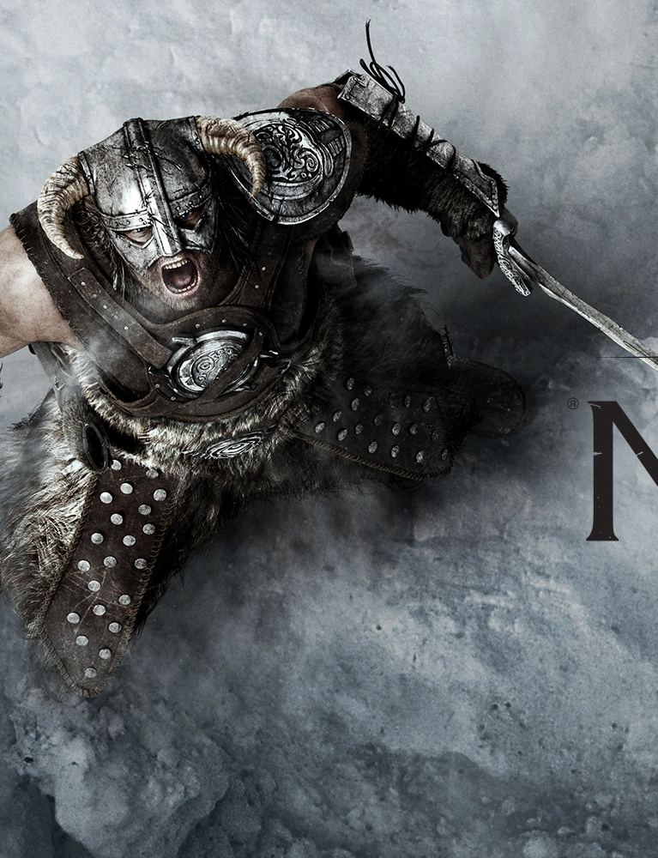
The 4 narrative layers:
Narrative situation
Narrative situation is the broad rules for the game
This is based on a code of conduct/culture
Morality – being good versus being bad
Notes:
What happens to players if they break the rules of the game?
Can they murder NPCs? If so, what if they murder a story person? Can the story adapt?
Most games do try and penalise bad deeds with punishments such as guards, punishment, death, banishment etc. Skyrim will have guards try and arrest you for pickpocketing, stealing or murder.
Some games allow the player to be rewarded for being bad as it satisfies a particular story outcome.

Slide 11
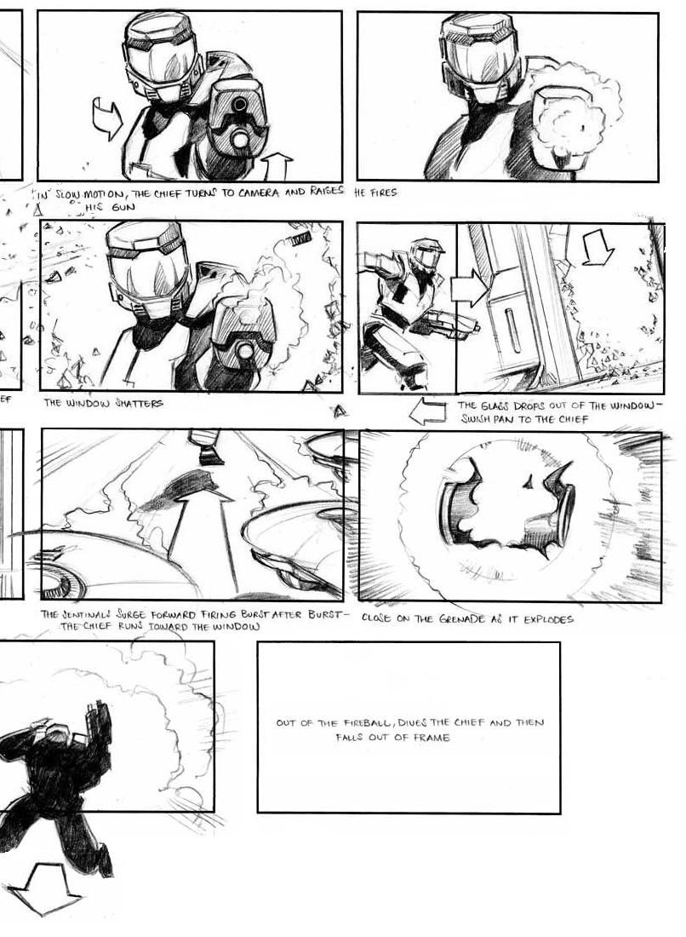
Storyboarding
Designed to show the sequence of gameplay or more commonly, detail cut scenes
Also provides info. on graphics, audio and text
Storyboarding was orginally developed by Disney in the 1930s
Used by most filmmakers

Slide 12




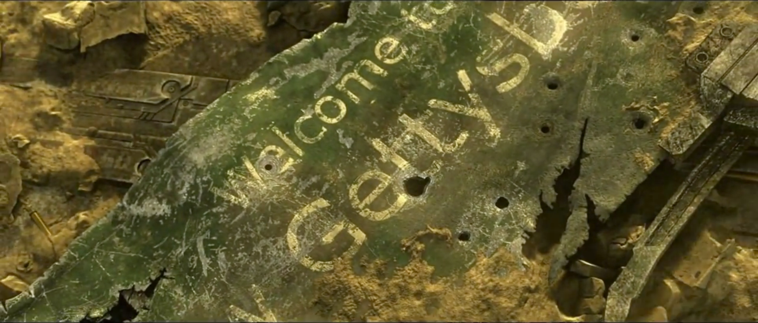
Videos:
Starcraft 2: Kerrigan
video
Storyboard
video
Cinematic
Notes:
Videos are in the folder in case there are issues with youTube

Slide 13

Task:
Create a storyboard for a cut scene from a game that you have played
or
Create a storyboard showing your typical day. Imagine it is the opening cut scene to a game based on your life

