Slide 1


Mechanics
THE JAMES YOUNG
HIGH SCHOOL
Game
Computer Games Development

Slide 2
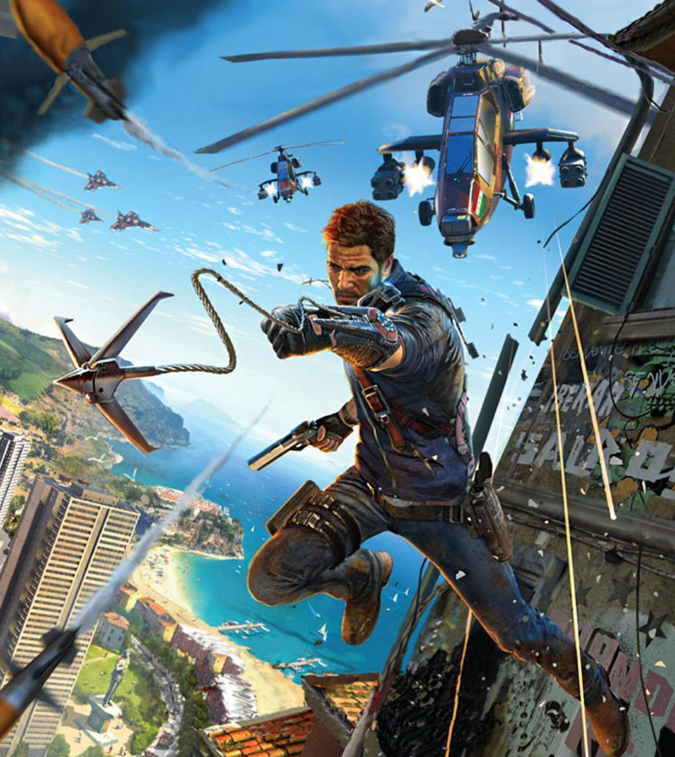
What are they?
These are rules that constrain a game’s interactivity.
They define what a player can do or how they can perform an action
Notes:
Image is from Just Cause 3. The grappling hook mechanic allows the player to move across the level at high speed. It also doubles up as a weapon.

Slide 3
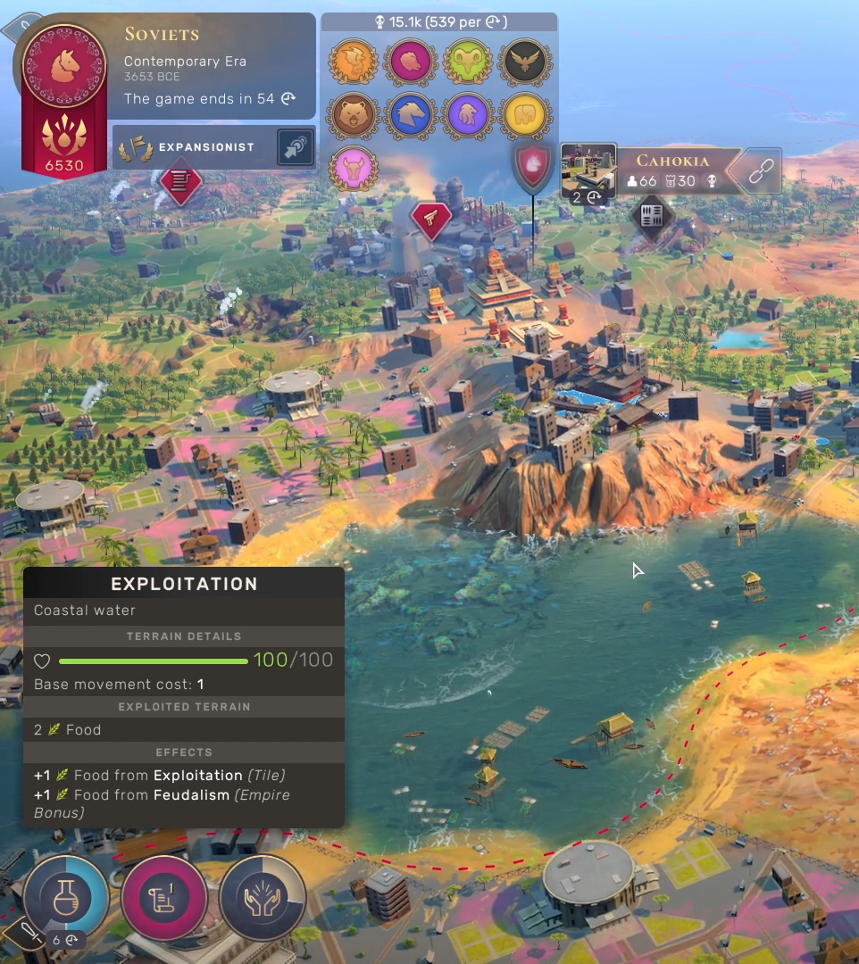
Turns
Turns allow time for strategy and evaluation.
We learn turn taking by playing board games and by playing sports.
Notes:
Image is from Humankind. In the game, players can perform different actions within their turn. When they end their turn, the computer takes a turn for the AI controlled players.

Slide 4
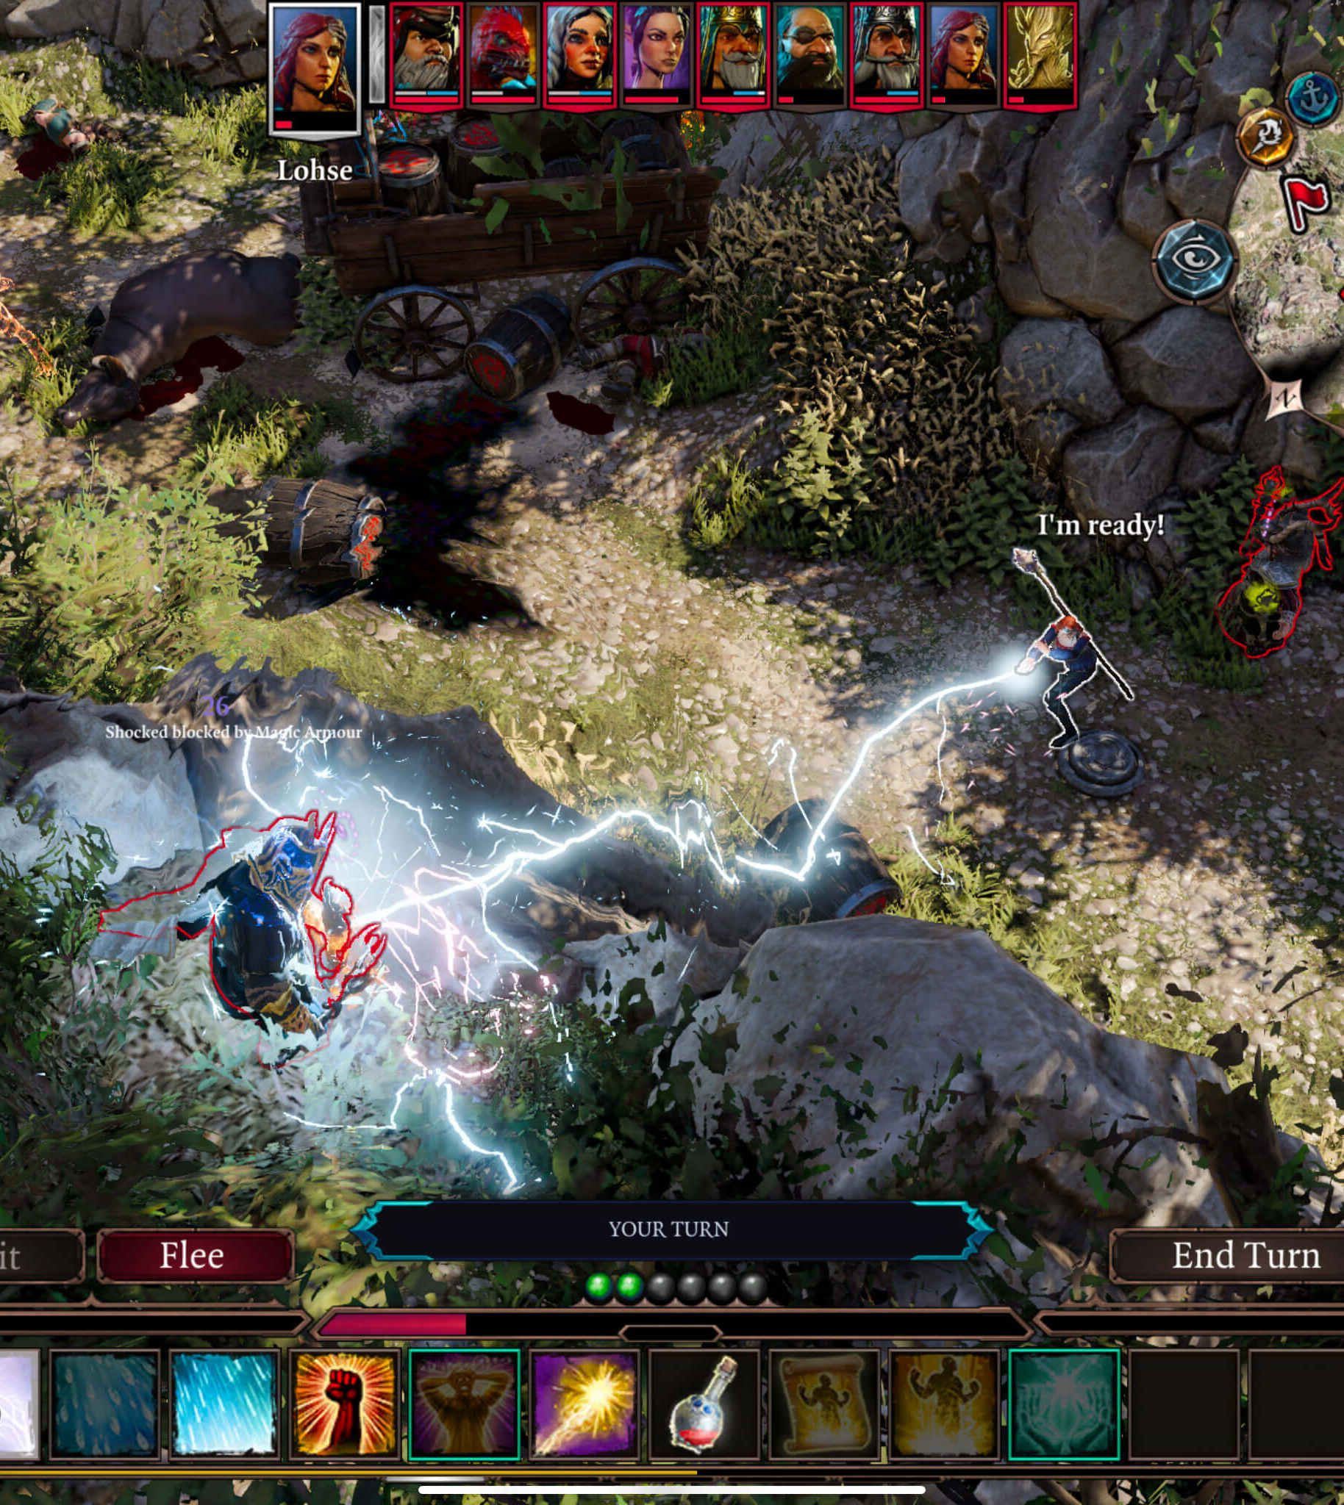
Action Points
These control what a player can do in their turn by allocating a budget of action points for each turn.
Usually these increase by one each turn.
Notes:
The image is from the game, Divinity: Original Sin 2. Action points are represented by the green orbs in the centre of the bottom toolbar. Each turn you acquire more. Spells and abilities cost different amounts of AP (Action Points). The spells that are greyed out and ones that cost more the 2AP and therefore cannot be used this turn.

Slide 5
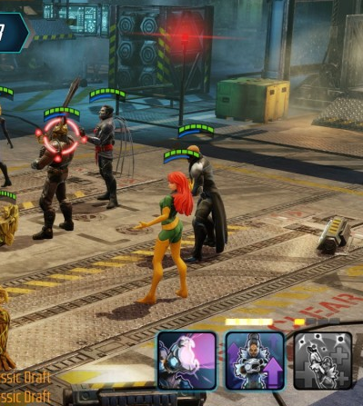
Action Points
An alternative to a central pool of action points is to have skills/abilities gain their own points.
When full (after a certain amount of turns), they can be used and then need to be built up again.
Notes:
The image is from the mobile game, Marvel Strike Force. Each character has a basic ability that can be used every turn and either 1 or 2 extra abilities that need time to build. The second ability shown is ready to use but the last one on the eight needs another 3 turns before it can be usable.

Slide 6
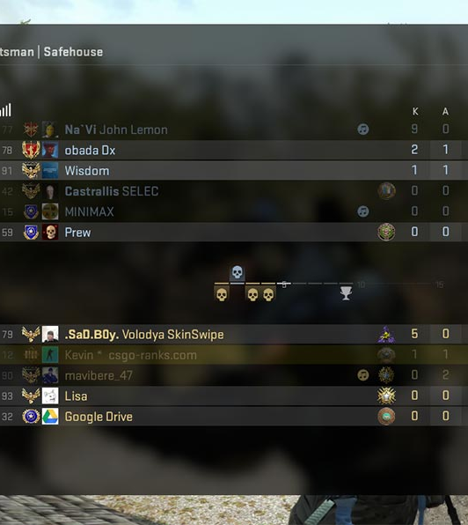
Capture/Eliminate
Best seen in FPS games where players are tasked with either capturing a point of interest or by eliminating enemies.
Kill counts or scores are how they are measured.
Notes:
Image is from CS:GO (Counter-Strike: Global Offensive). The table shows how many Kills a player has as well as Assists. Deaths and other stats are also shown. Some games such as Team Fortress 2 also have a score. You increase your score by not only killing enemies but also by completing objectives such as recovering a briefcase, capturing points etc. This means more passive classes such as Medics and Engineers can sit at the top of the table despite killing the fewest enemies.

Slide 7
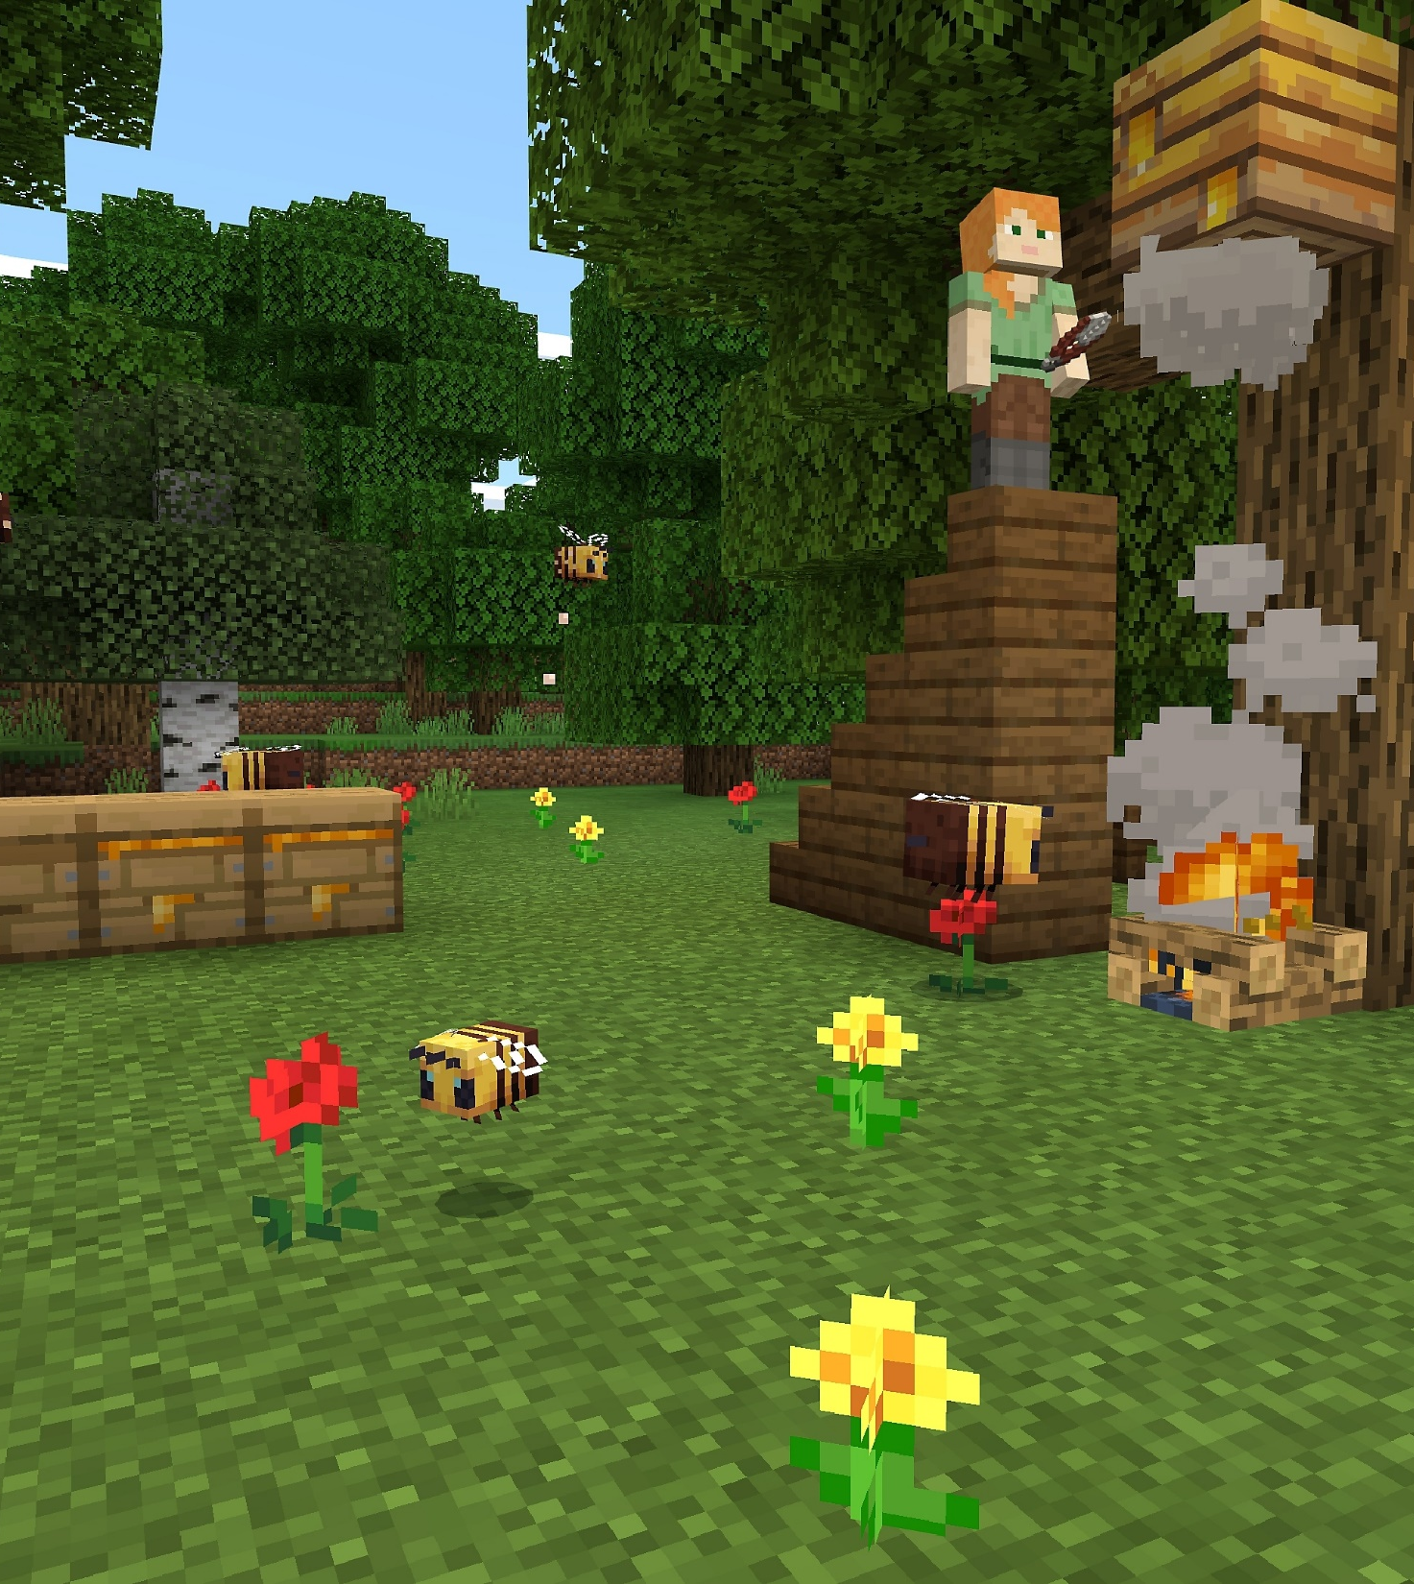
Resource Management
Resources can be anything from money to stone to squad units.
There will be rules on how these resources can be accumulated, managed and lost
Notes:
The image is from Minecraft. Players have to gather resources in order to craft new items or build structures.

Slide 8
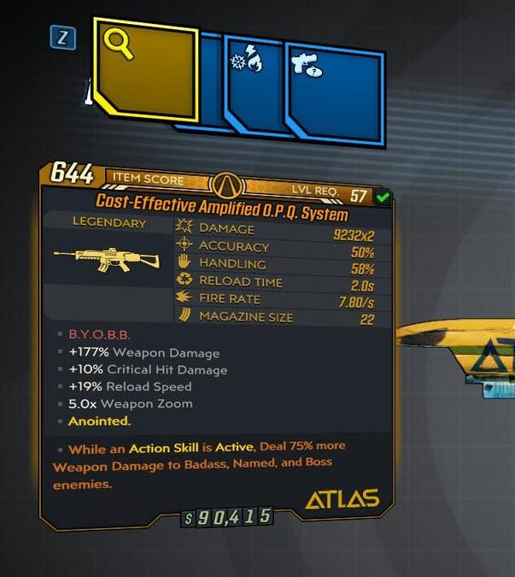
Dice
Dice add a random element to a game. They come in different varieties D6, D3, D8 etc.
A lot of modern games employ RNG (random number generators) when spawning loot, calculating damage or scripting events.
Notes:
The image is from Borderlands 3. Each gun’s attributes are randomly generated.
RPGs use “Dice” when calculating damage. This usually involves working out how attack damage and accuracy compare to armour, deflection or shields.
The Random Number Generator can also add an element of chance to games by generating an attack at random points in a player’s journey.

Slide 9
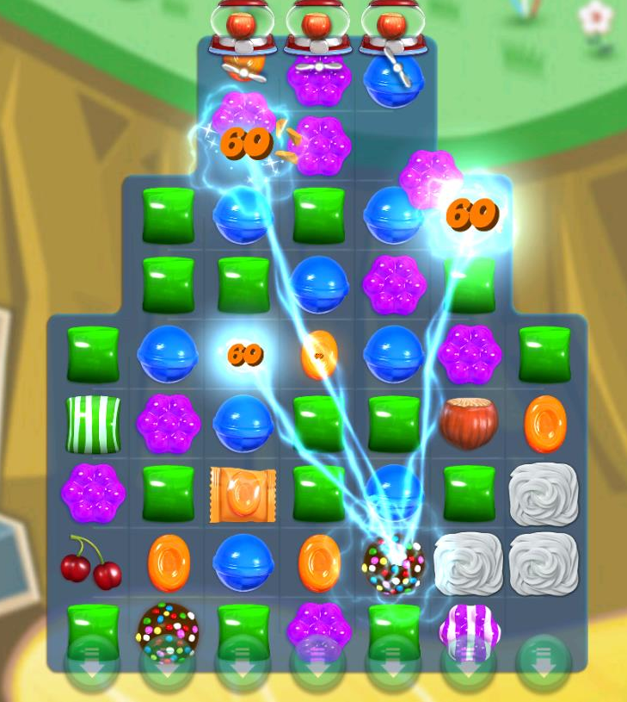
Game Modes
Aside from the modes discussed in Gameplay, items can alter the mode of the game itself.
Boosters can modify the game to be both beneficial or detrimental to the player e.g. power-ups
Notes:
Image is from the mobile game, Candy Crush Saga. The game is a take on the gem swapping games and players need to clear the board by matching sweets. A number of boosters alter the game mechanics in unique ways. The image shows a Colour Bomb removing multiple sweets at once.

Slide 10
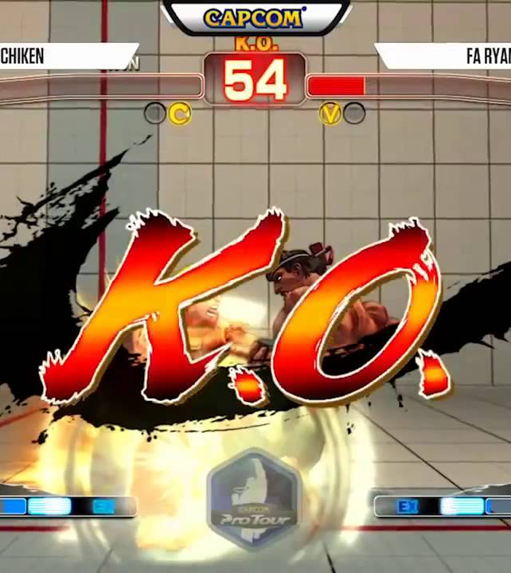
Victory Conditions
These determine how a player wins the game.
They can vary quite drastically, from defeating the final boss to scoring more goals than the opponent.
Notes:
Image is from Street Fighter V.

Slide 11
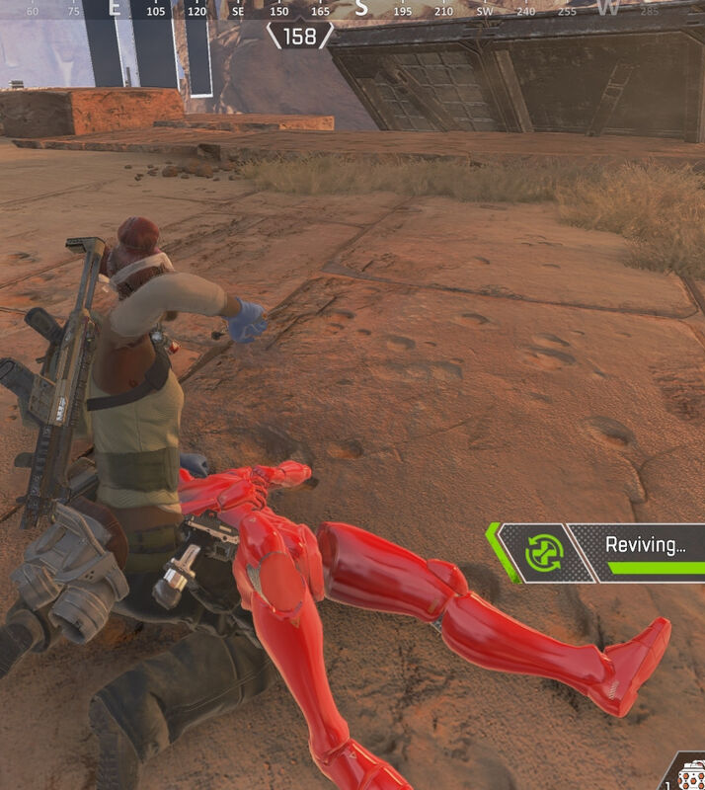
Health
How a player gains, uses or even loses health is governed by a mechanic.
Notes:
Image is from Apex Legends. Players who lose their health have to wait for a teammate to “revive” them (This is called Down But Not Out or DBNO). Some games let you revive yourself by killing another enemy whilst in DBNO.
Do players regenerate health over time?
Is health used to fuel abilities e.g. blood magic?
Does health keep dropping until a player performs an action (bandage)?
Lose a life
Restart from checkpoint
Restart level/game
Perma-death (requires creating a brand new character and starting the game from the beginning

Slide 12
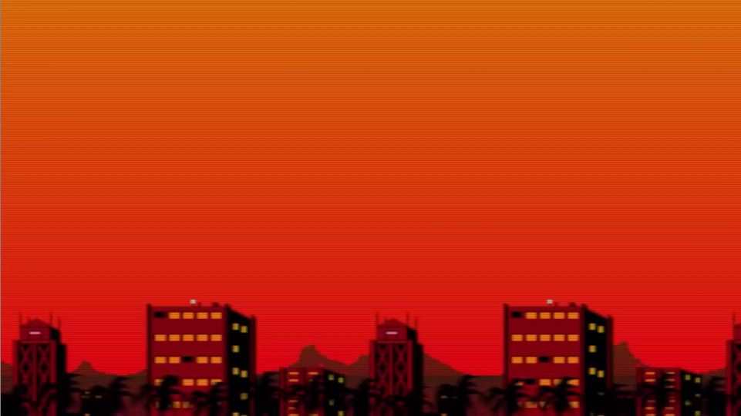

Unique mechanics
video
10 video games with unique game mechanics
Notes:
Video - https://www.youtube.com/watch?v=PPmNPvrUgpc (14mins 50)

