Slide 1
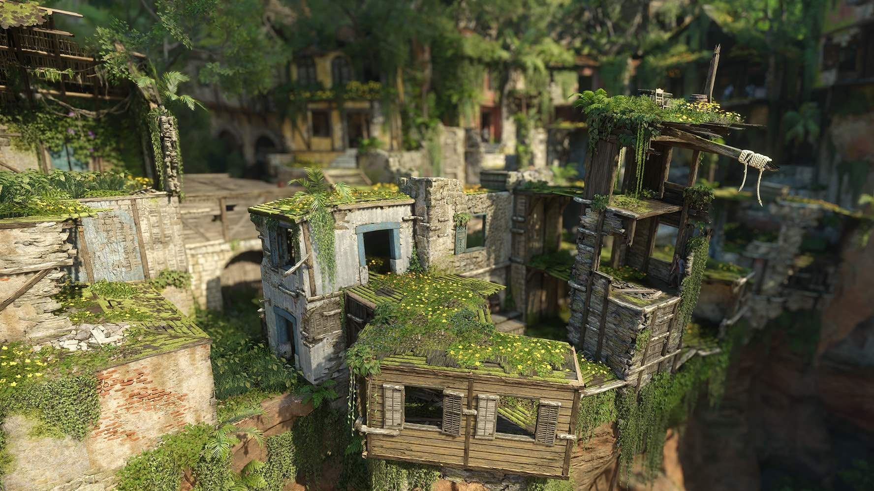

THE JAMES YOUNG
HIGH SCHOOL
Level Design
Computer Games Development
Notes:
Level design is a difficult thing to teach and it really does depend on the genre of the game. This powerpoint is more designed to help pupils write better descriptions of their levels for the NPA course. This first few slides provide examples of how levels can change depending on the goals of the game. There are also several screenshots of games in a folder that can be used with a class to help them practise their descriptive writing.

Slide 2
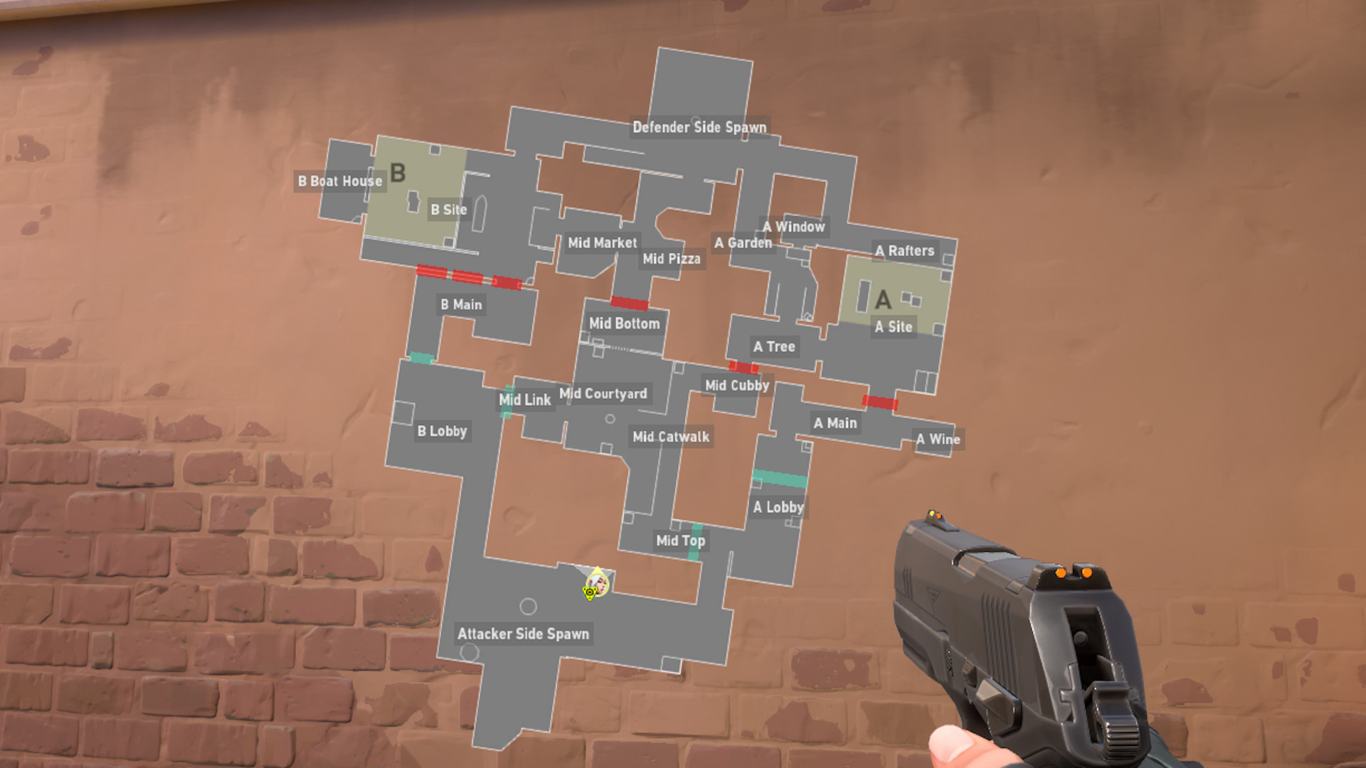
example:
valorant
Notes:
Valorant is a competitive First Person Shooter
Maps in this genre need to allow multiple access routes to various points. You can see from the image that the defending team start the game at the top and are closer to the target sites (A and B). This will allow them to defend and hold these positions to prevent the enemy team from winning.
The attackers start at the bottom of the map and take longer to work their way up to points A and B. There are also multiple routes to both sites which makes it more difficult to defend.
Counter-Strike was one of the first games to pioneer this style of level design.

Slide 3
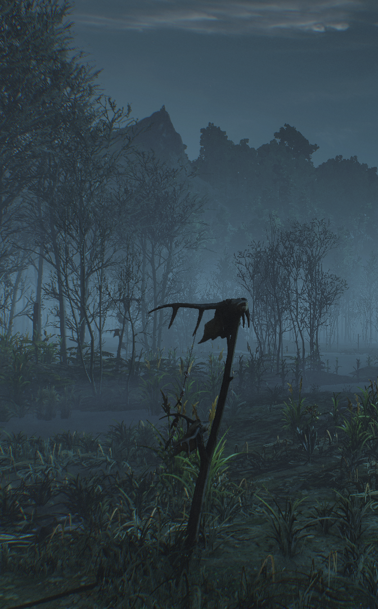
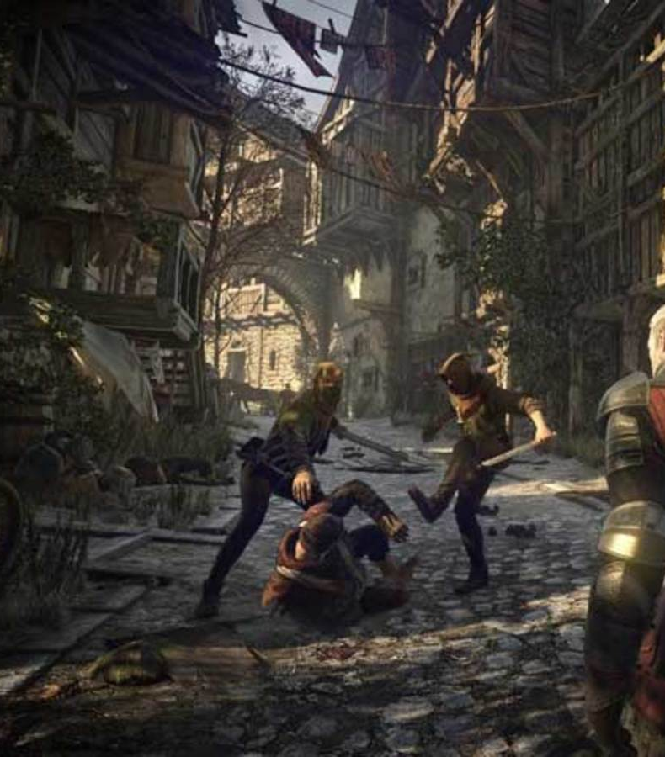
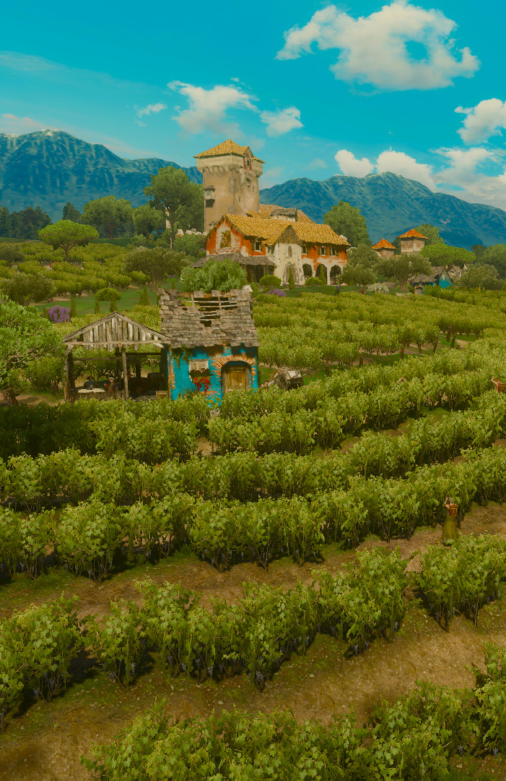
example:
The Witcher: Wild Hunt
Notes:
All three areas are from the same game – The Witcher: Wild Hunt . This is an open world RPG.
The swamps feature dead trees, bogs that come up to your knees. There’s a fog that lingers around the ground and visibility is poor. Weather is always overcast and in some cases, it rains but there’s never any sun. Lots of ambient swamp noises and there are leftover pieces of people and animals that have died in the swamp.
All the cities in the game have areas that reflect who lives there. The image above is from a poorer area – the houses are very close together with some built on top of each other. Washing is hung out across the main street and there’s little light here. There’s rubble and rubbish on the streets showing they’re neglected. Attacks happen here as it’s a dangerous neighbourhood due to poverty and ill health. There’s a lot of ambient noise here leaking from inside the houses. People shouting, stray animals barking and fighting. You can often pass through here and get insulted by NPCs.
The last image is of a vineyard. It’s always bright and sunny here, the foliage is lush and healthy. A few farm buildings are scattered around and there are people working the fields. There are birds chirping and the wind can be heard blowing across the bushes.

Slide 4
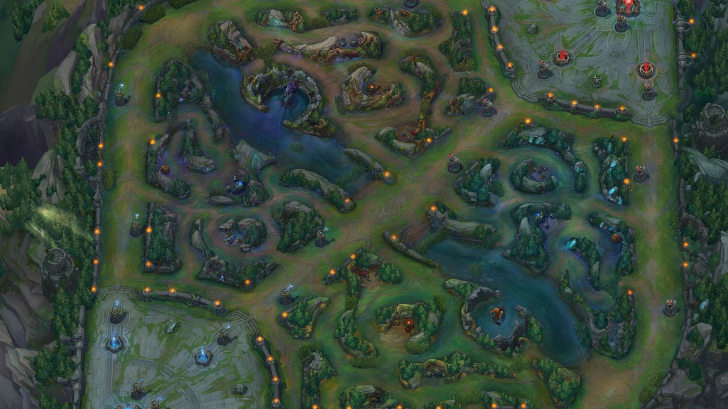
example:
League of Legends
Notes:
League of Legends is Multiplayer Online Battle Arena (MOBA) game that puts teams of players at opposite ends of a map. Their goal is to capture/destroy their opponents starting ground (usually crystals or buildings). The maps are symmetrical so that neither side has an advantage over the other. Like Competitive FPS, there are multiple routes through the map. The look of the map is usually a secondary thought as players focus on their opponents and balance attacking and defending.

Slide 5

NPA Computer Games Development
For this course you will need to be able to describe levels from existing games and also describe levels for your own game
Lots of detail here means I have a clear image in my head of what you’re designing.
This will also make it easier for you to create the level, saving time

Slide 6

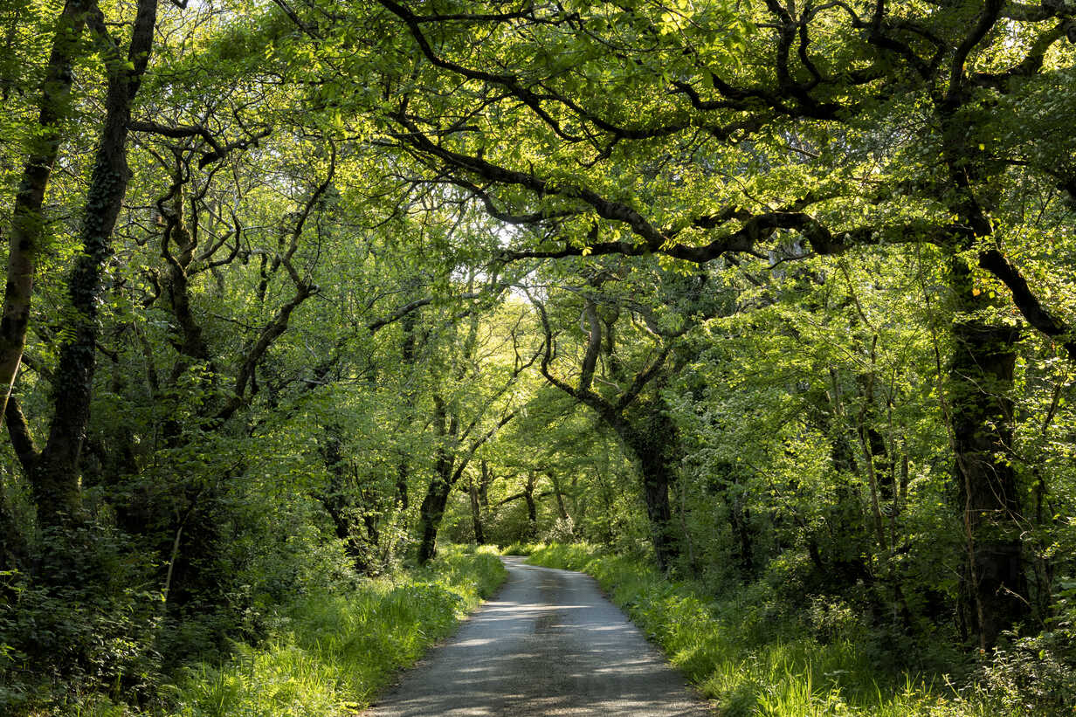
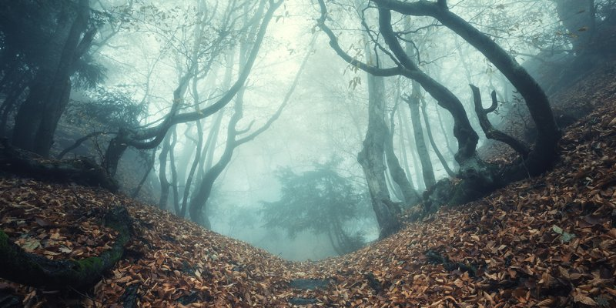
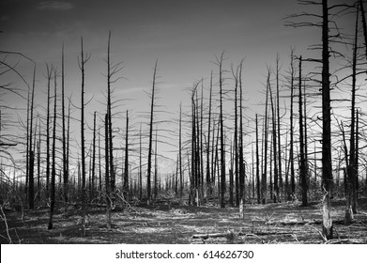
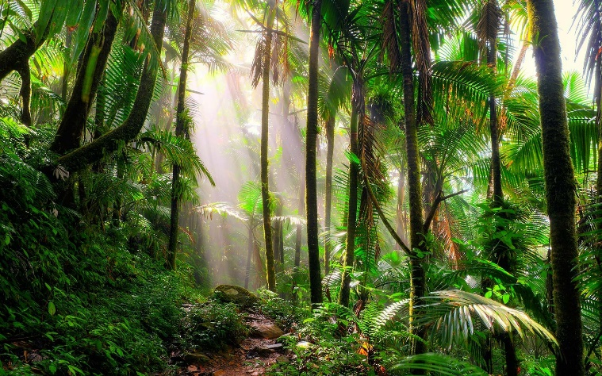
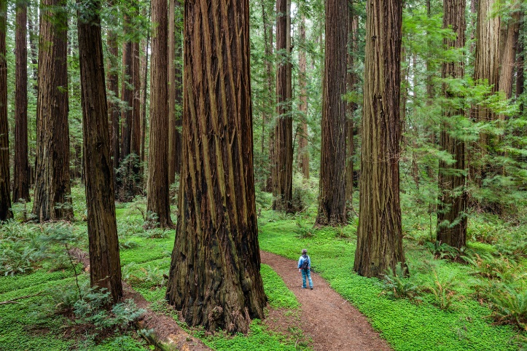
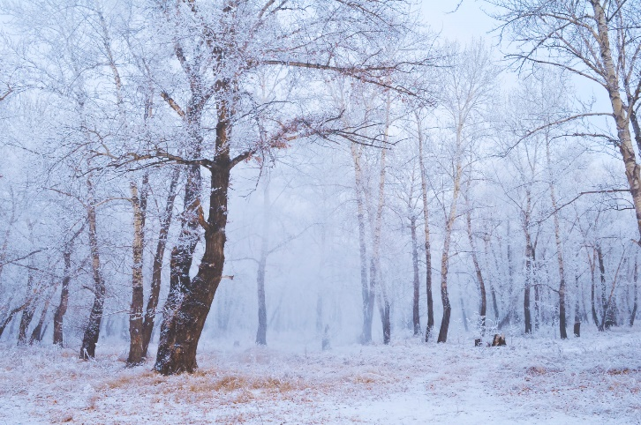
Case study:
A forest
“ My game will be set in a forest.”
Notes:
I have had a pupil use this sentence for their level design and that was all they’d written. The images here are to help them understand that forests are wildly different. There are questions on the next slide that can help them get a clearer picture in their head of the type of forest they want.

Slide 7
Case study:
A forest
“ The main character lives in a small, old log cabin deep within a cursed forest. The trees are tall with thick leaves that start half-way up. They’re closely packed together which blocks out a lot of light so it’s quite dark. Some trees have been felled and lay on the ground as the player uses the wood for various things. Birds can be heard and there are small mammals that live under the spongy, soil...”
What do the trees look like?
How light/dark is the forest?
What time of day is it set in?
What does the ground look like?
Is it noisy/quiet?
Are there animals?
What’s the weather like?
Do people live there?
Is it a realistic forest?
Notes:
I’ve written the right paragraph as an example of how to expand the basic “it’s a forest” into something more descriptive. Even if pupils are strong with literacy, they could answer the questions on the left and then turn those into sentences.

Slide 8

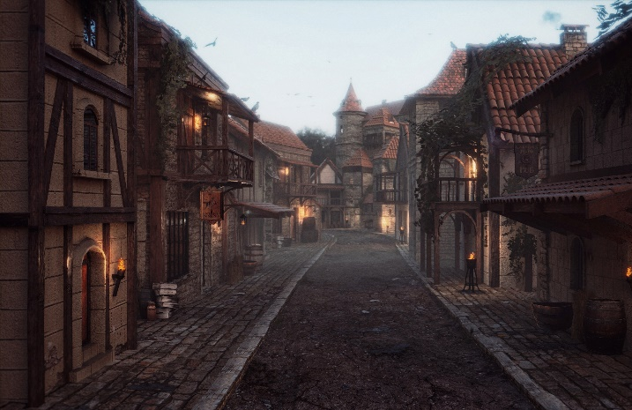
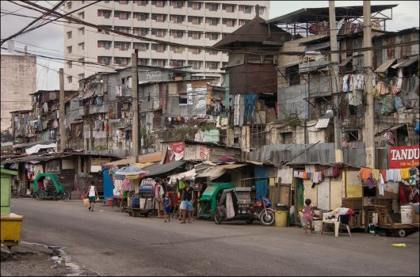
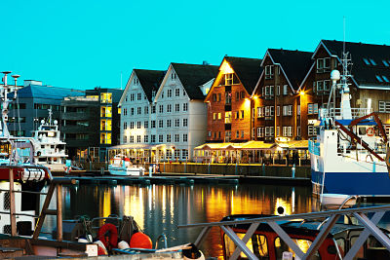
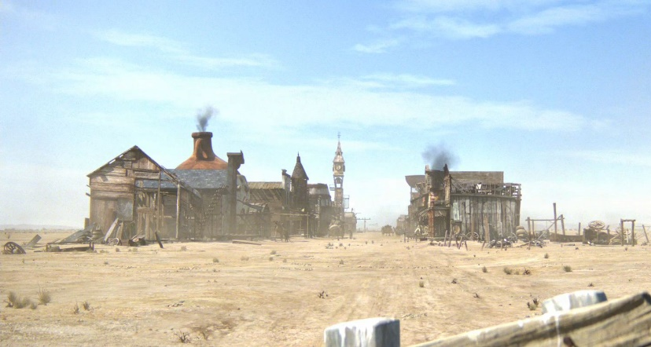
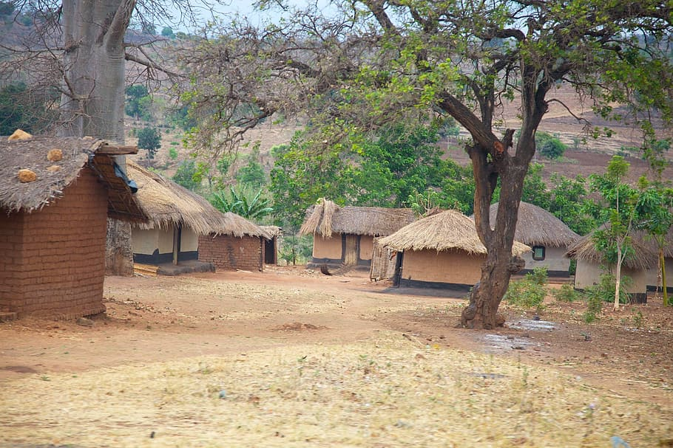
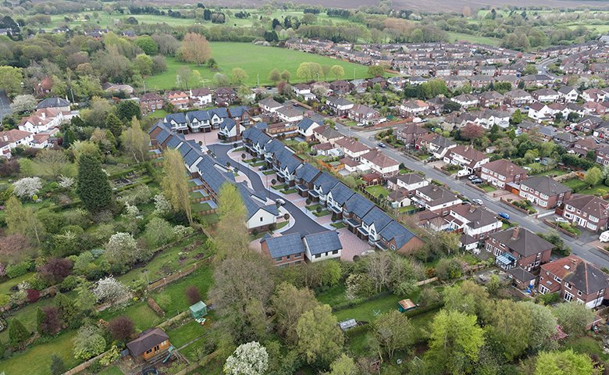
Case study:
A town
“ One level is in the town of Ginster.”
Notes:
Similar to forests, some pupils aren’t very expressive when it comes to describing towns.

Slide 9
Case study:
A town
“ The town of Ginster sits at the bottom of a mountain and was a flourishing, gold mining community when founded in 1877. It’s now 1956 and the gold has gone along with many of the residents. Half of the wooden, single-storey houses have been boarded up or are derelict. There has been little upkeep done to the roads and pavements and residents are suspicious of outsiders. It’s quiet but dogs often bark...”
What time period is it set it?
What is the architecture like?
Is it inhabited?
How many people live there?
Is it a rich/poor town?
Are there shops/parks?
What’s the weather like?
Is it a realistic town?
Who runs it?

