Slide 1
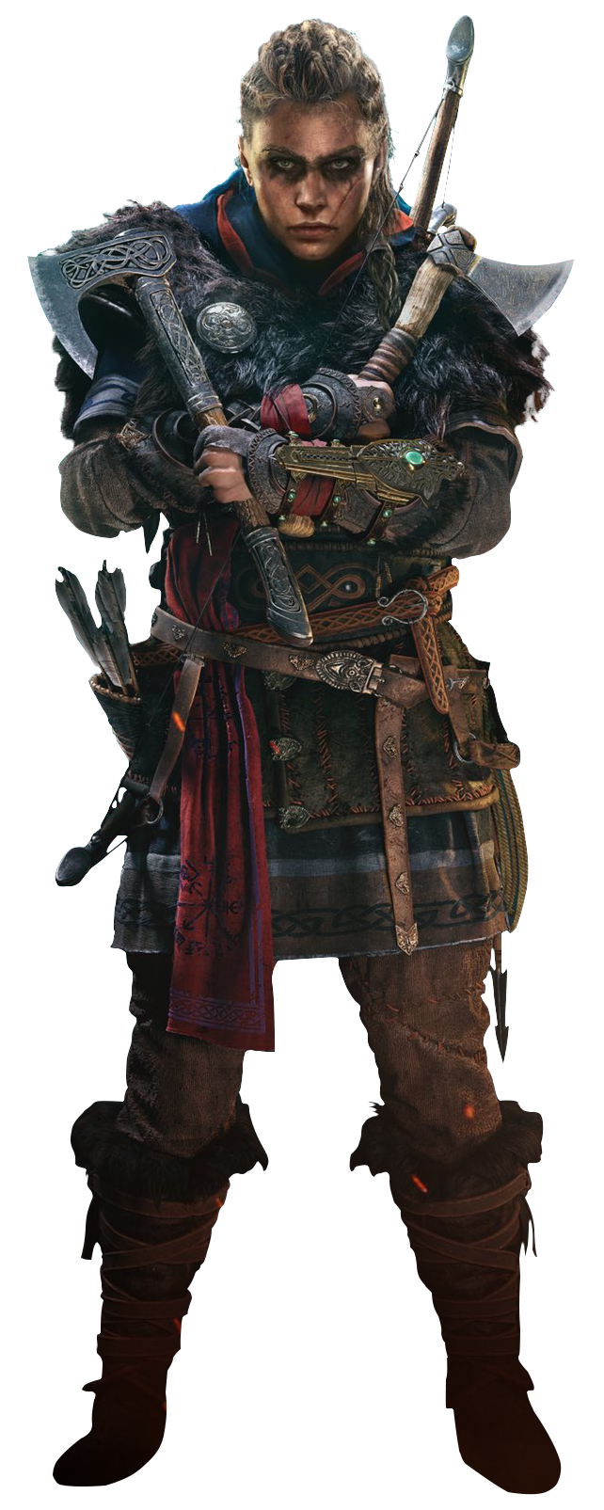


THE JAMES YOUNG
HIGH SCHOOL
Computer Games Development

Slide 2
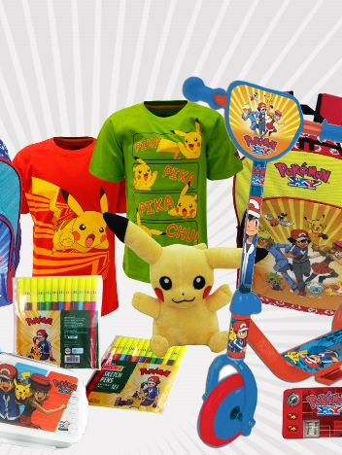
Characters must be designed in a way that fits with the story and plot of the game
All characters in the game are designed, from the main characters to NPCs
Good character designs can increase sales and merchandise

Slide 3
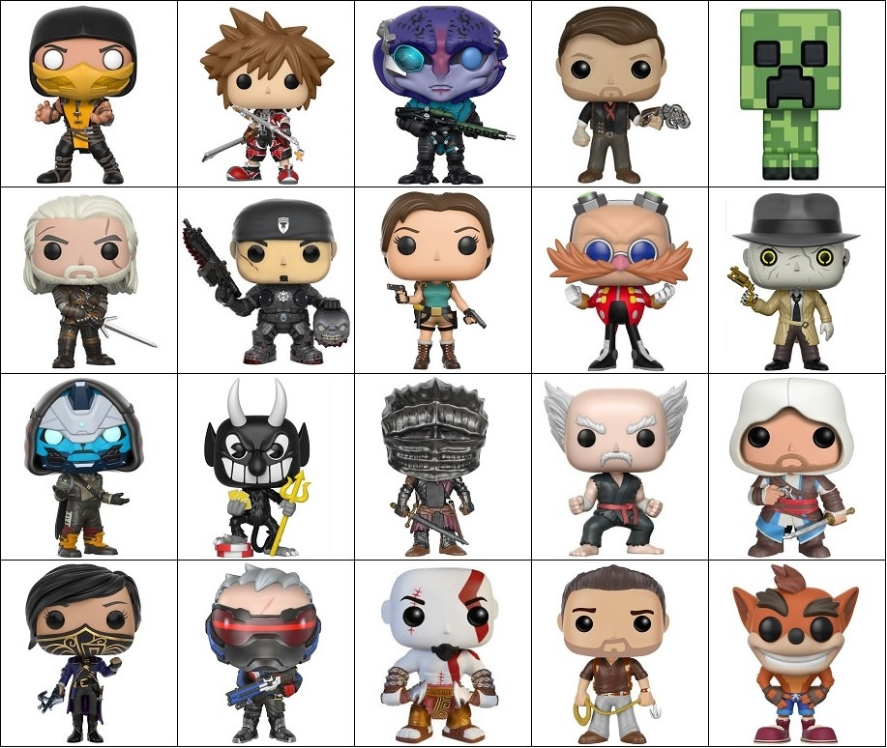
Who’s who?
Notes:
Working from top down, left to right
Mortal Kombat – Scorpion
Kingdom Hearts - Sora
Mass Effect Andromeda - Jaal
Bioshock Infinite – Booker de Witt
Minecraft – Creeper
The Witcher: Wild Hunt – Geralt
Gears of War – Marcus Fenix
Tomb Raider – Lara Croft
Sonic the Hedgehog – Doctor Robotnik
Fallout 4 – Nick Valentine
Destiny – Cayde-6
Cuphead – The Devil
Dark Souls 3 – Red Knight
Tekken - Heihachi
Assassin’s Creed 4: Black Flag - Edward
Dishonored 2 - Emily
Overwatch – Soldier 76
God of War – Kratos
Uncharted 4 – Nathan Drake
Crash Bandicoot – Crash Bandicoot
You could make this a quick game – 1 point for character, 1 point for the game

Slide 4
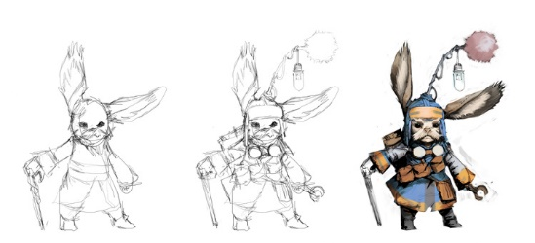
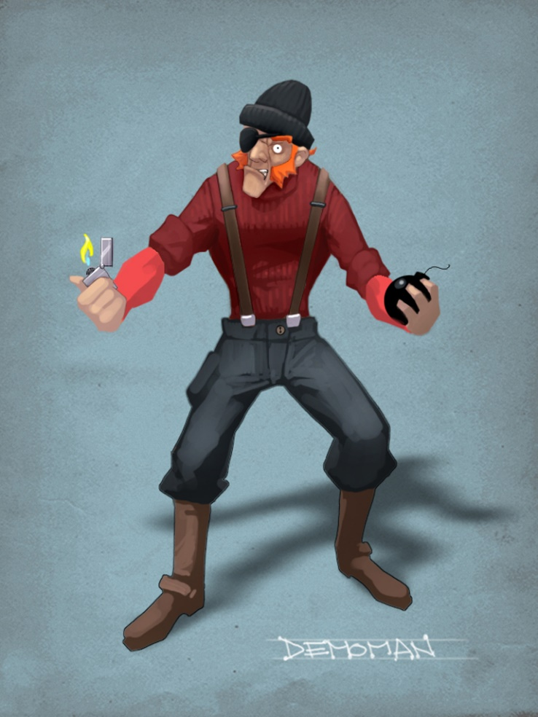
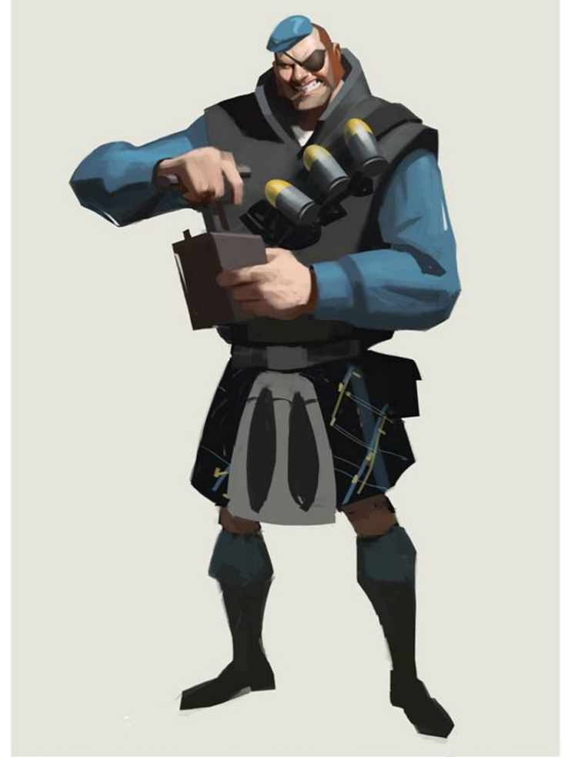
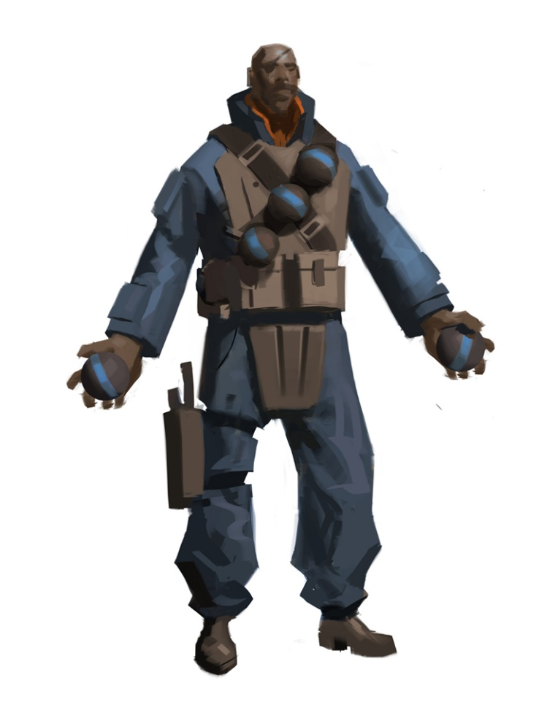
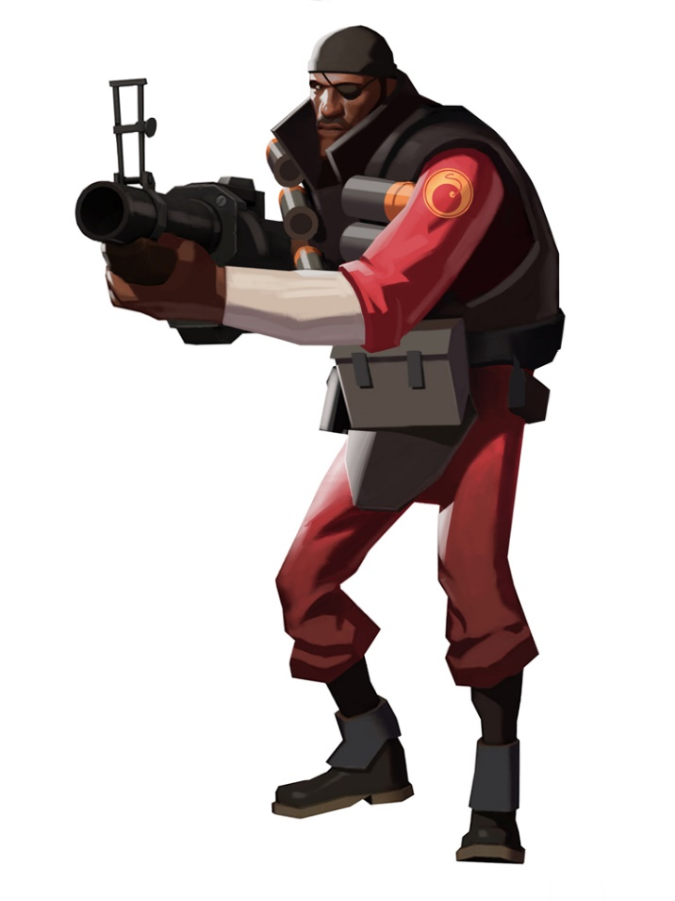
The 2D Artist
2D Artists will quickly draw a number of sketches that evolve with feedback from the design team
Notes:
There is an excellent post about the design process for the Demoman design from the game Team Fortress 2 (shown in the slide).
The demoman’s final design is shown on the right
https://www.teamfortress.com/post.php?id=1783

Slide 5
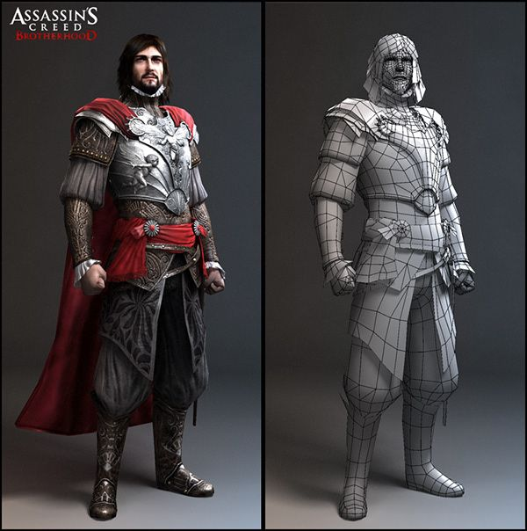
The 3D Artist
Once the design has been finalised, 3D Artists create wireframe models
These are then rendered with the full design
Notes:
Whilst Level 6 candidates are expected to create a 3D asset, there’s no requirement to create a 3D model such as the one above. I’m not even sure if Blender would run on school-level PCs?
https://www.3dslash.net/index.php is a nice online site for doing simple 3D sculpting. Level 6 pupils can create a simple 3D model here but this doesn’t necessarily need to be added to their game. The SQA assessment only requires that they plan and make a 3D asset.

Slide 6
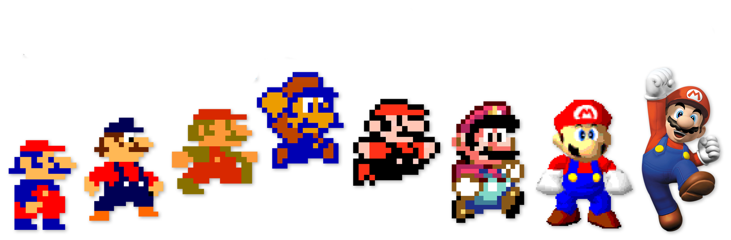
Design evolution
As games turn into franchises, character designs must evolve with better hardware
The next few slides showcase 3 characters and how they have changed with each game they’ve appeared in

Slide 7
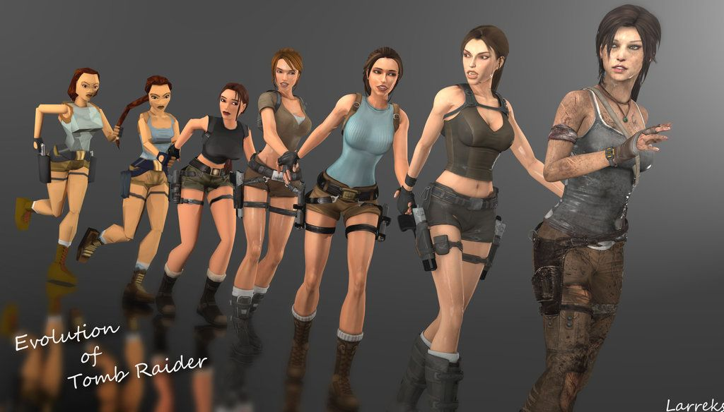
Case study:
Lara croft
Notes:
There are iconic aspects to Lara Croft’s designs such as the shorts, gun holsters, blue top, ponytail. Over the years some of these have changed, for example, in the most recent games, Lara wears trousers, which helps try and ground the character in reality. It may be worth mentioning the sexualisation of the character in the early days.
With an increase in polygons for 3D models, more accurate models can be created, leading to today’s Lara Croft. She still has a blue top (dirty as it is) and the holster for a weapon and whilst other elements have been toned down or removed, she’s still recognisable as Lara Croft.

Slide 8
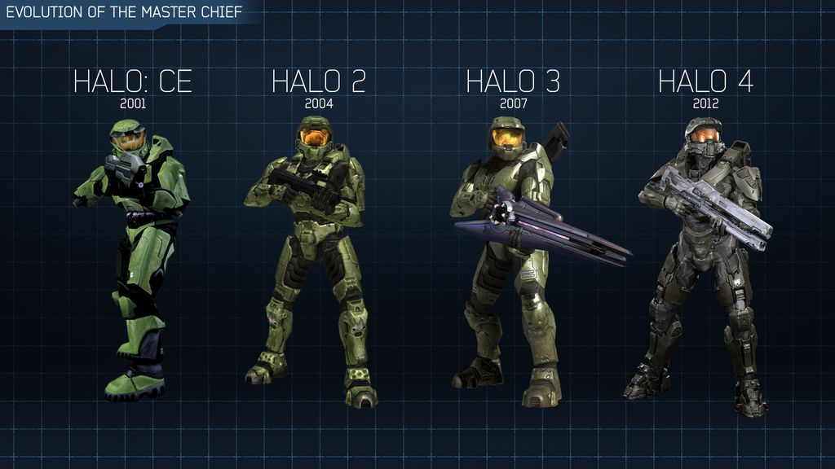
Case study:
master chief
Notes:
Master Chief from the Halo games still holds onto a fair amount of the original design. Whilst the colour has changed the overall shape is still there. With the increase in polygons, more detail has been added to his armour to make it look more like military equipment. The armour looks heavy and complete functional. The iconic visor is still there.

Slide 9
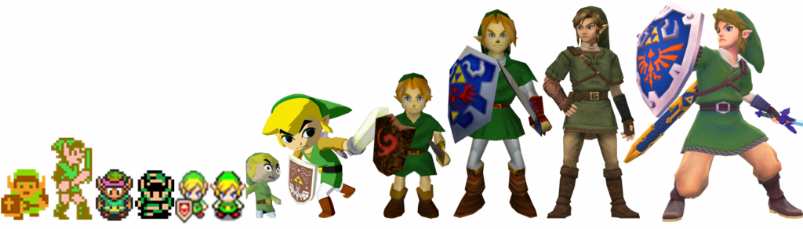
Case study:
link
Notes:
Link from the Zelda games has a really interesting evolution. Given how old the games are, Link has made the transition from bit-map graphics to vector graphics to 3D models. The original designs featured overly large ears due to limited storage space, forcing designers to overemphasise these to players. Links ears have become smaller thanks to higher resolution models. Link’s colour scheme still remains – green outfit with green hat, belt, sword and shield.

Slide 10

NPA Computer Games Development
For this course you will need to be able to describe the characters in your games
Lots of detail here means I have a clear image in my head of what you’re designing
This will also make it easier for you to create them, saving time

Slide 11
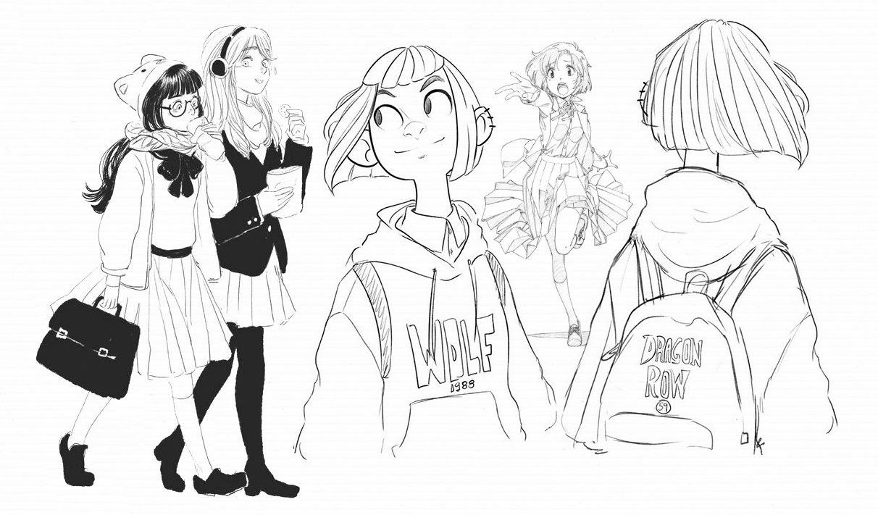
Case study:
A teenage girl
“ The main character is a 14 year-old girl called Zaza. She has short black hair, dark hazel eyes and wears slim, black glasses, which she’s blind without. Her family moved from Hong Kong to Edinburgh just before she was born. Zaza is self conscious about her body as its changing and wears baggy hoodies. She’s thinking about dying her hair but is worried about what her family would say. She hates school but enjoys going there to meet her friends, Zoey and Alix.”
How old is the character?
What gender do they identify as?
What skin tone do they have?
Any visible features?
What clothes do they wear?
What’s their build?
Where are they from?
What’s their personality like?
A brief history
“ The main character is a teenage girl called Zaza.”
Notes:
Any visible features might include piercings, glasses, facial hair, scars, tattoos, implants (e.g. bionics) etc
For build, they can talk about height, weight. Does the character have a healthy lifestyle?
Personality is an interesting one as it can really bring a character to life.

Slide 12
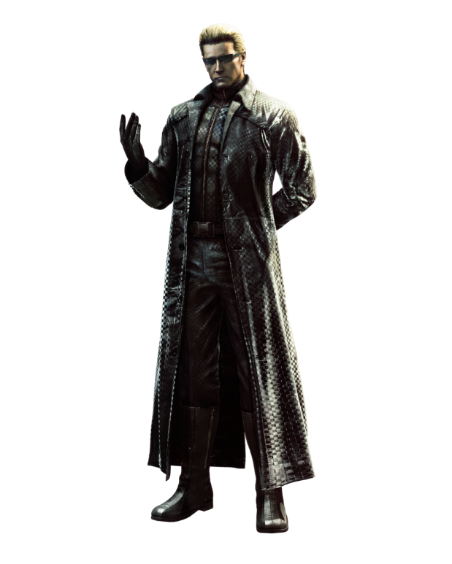
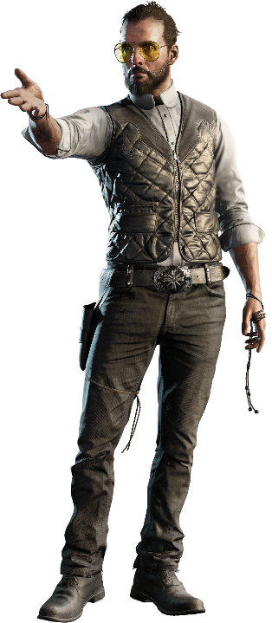
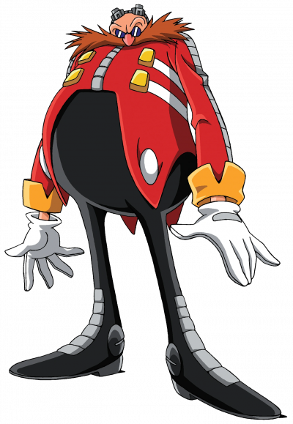
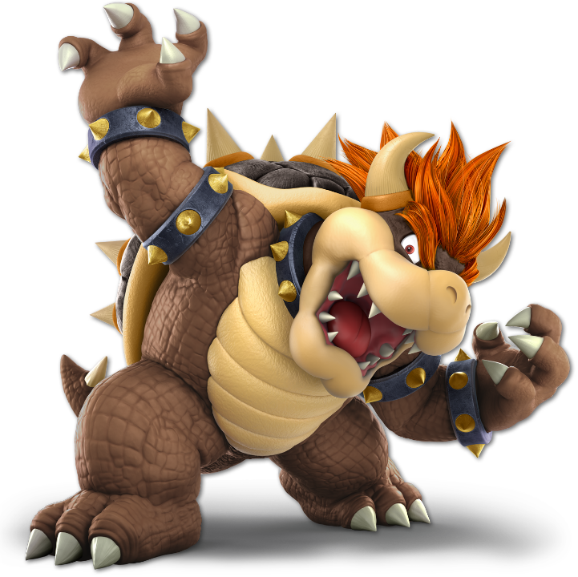
NPA Computer Games Development
It would be a good idea to detail not just the main character(s) but also the main antagonist or villain. You could also design basic enemies if you don’t plan on having a main villain.
Notes:
Villains left to right
Dr. Robotnik (Sonic the Hedgehog)
Bowser (Mario games)
Albert Wesker (Resident Evil games)
Joseph Seed (Far Cry 5)

