Slide 1
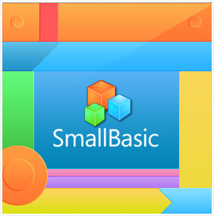
Microsoft Small Basic
An introduction to Programming

Slide 2

Microsoft Small Basic
Computer Programming is defined as the process of creating computer software using programming languages.

Slide 3

Microsoft Small Basic
Just like we speak and understand English or Spanish or French, computers can understand programs written in certain languages. These are called programming languages. In the beginning there were just a few programming languages and they were really easy to learn and comprehend.

Slide 4
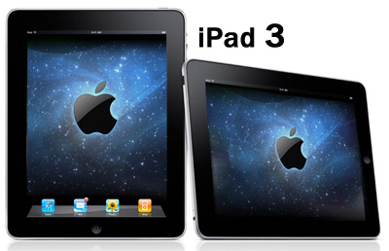
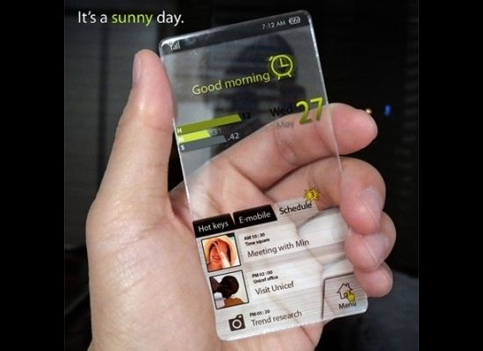
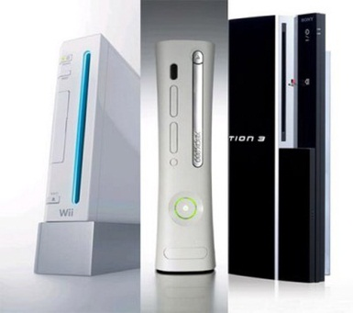
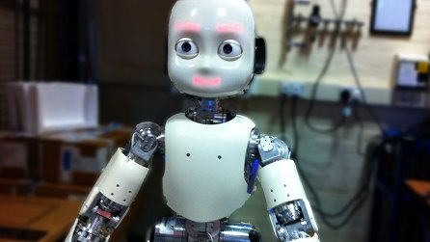
Microsoft Small Basic
As computers and software became more and more sophisticated, programming languages evolved fast, and have become more complex.
Think about iPads, x-box, smartphones, robots.

Slide 5
Microsoft Small Basic
Small Basic is a programming language that is designed to make programming extremely easy, approachable and fun for beginners.
Small Basic is a stepping stone to the amazing world of computer programming.

Slide 6
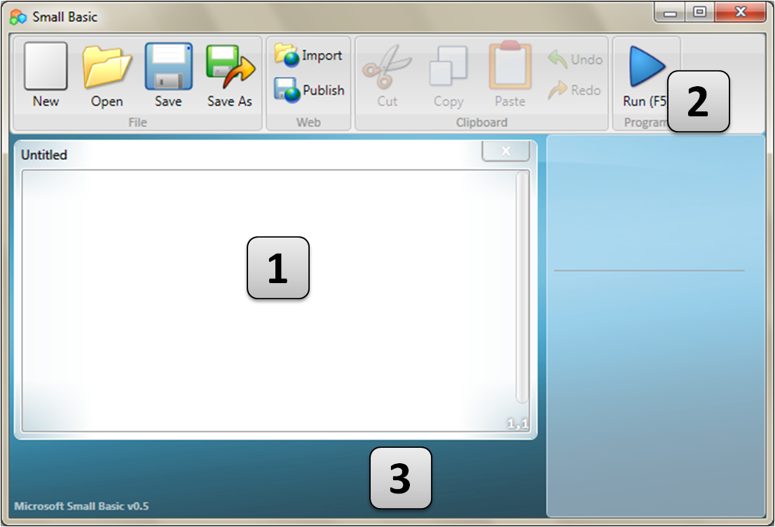
Microsoft Small Basic Environment
The Toolbar [2] is used to issue commands that we will learn about as we go along.
The Editor [1] is where we will write our Small Basic programs. Your program will show up on this editor.
The editor that contains the program you are currently working with is called the active editor.
The Surface [3] is the place where all the editor windows go. If the program has an error it will show you where it is in this box.

Slide 7
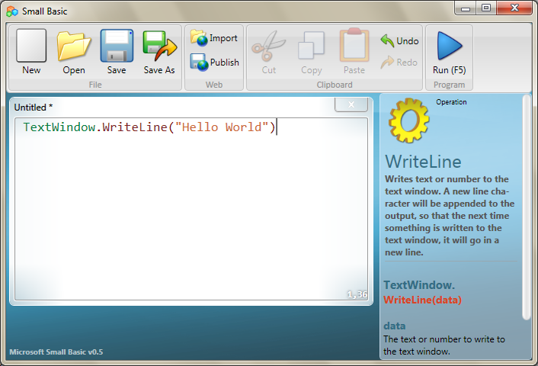
My First Program
Let’s go ahead and type the following line in the editor.
World")
This is our first Small Basic program. And if you have typed it correctly, you should see something similar to the figure below. Save it as my first program and run it.
TextWindow.WriteLine("Hello World")

Slide 8
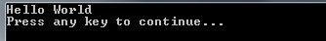
My First Program
This is what it looks like!!

Slide 9
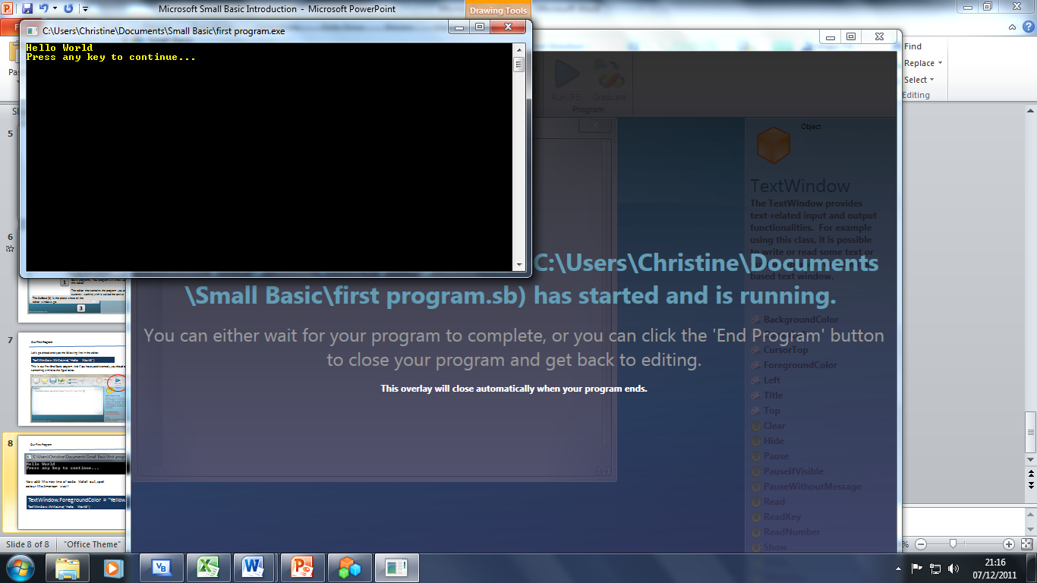
My First Program
Now add this new line of code. Watch out, spell colour the American way!! Remember to save it first.
TextWindow.ForegroundColor = "Yellow" TextWindow.WriteLine("Hello World")

Slide 10
What really is a program?
A program is a set of instructions for the computer.
Instructions tell the computer precisely what to do, and the computer always follows these instructions.
Every line of the program is a statement and every statement is an instruction for the computer.
When we ask the computer to execute a program, it reads the first statement.
It understands what we’re trying to say and then executes our instruction.
Once it’s done executing our first statement, it comes back to the program and reads and executes the second line.
It continues to do so until it reaches the end of the program. That is when our program finishes.

Slide 11
What really is a program?
This is a very simple program that consists of two statements.
TextWindow.
ForegroundColor = "Yellow"
TextWindow.WriteLine("Hello World")
WriteLine("Hello World")
ForegroundColor = "Yellow"
Text Window – known as an object
The statements give the computer instructions to change the colour to yellow and then write a line of text which is Hello World, into the Text Window.

Slide 12
What really is a program?
Experiment –
Go back to my first program and change the lines of code around. Make the first statement the second and the second the first. What happens?
TextWindow.WriteLine("Hello World")
TextWindow.ForegroundColor = "Yellow"

Slide 13
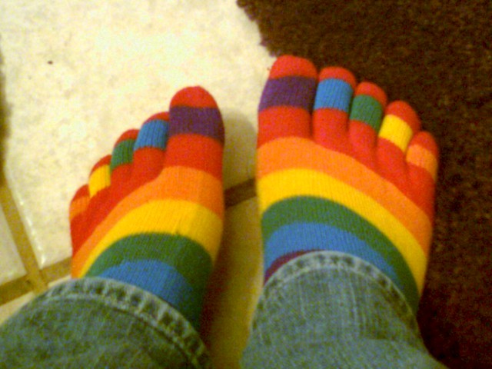
What really is a program?
So computers can only do the statements in order you have written them in.
You wouldn’t put your shoes on first and then your socks!!

Slide 14
Knock Knock Program
Now write a new program to say a “knock knock” joke and make each line of the code a different colour (color).
Black
Blue
Cyan
Gray
Green
Magenta
Red
White
Yellow
DarkBlue
DarkCyan
DarkGray
DarkGreen
DarkMagenta
DarkRed
DarkYellow
Knock Knock!
Who’s there?
Cash!
Cash who?
No thanks, but I’d like some peanuts!”

Slide 15
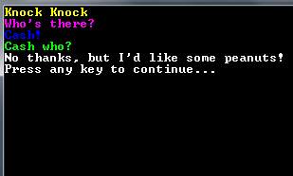
Knock Knock Program

Slide 16
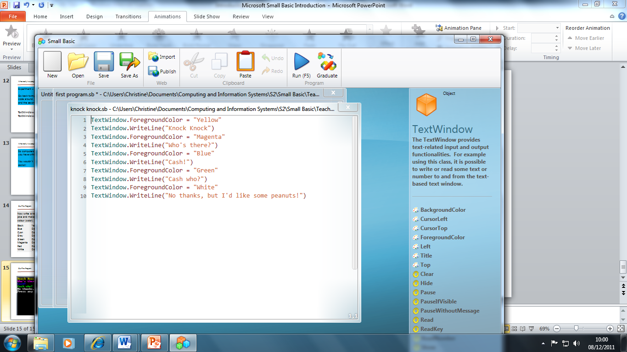
Knock Knock Program
Some of you might have realised that you can copy and paste the instructions. It saves typing time and there are less mistakes!!

Slide 17
Congratulations – you can now program in Small Basic.
From now on we will use the notes your teacher will give you to learn more amazing programming skills.

